Slide 1

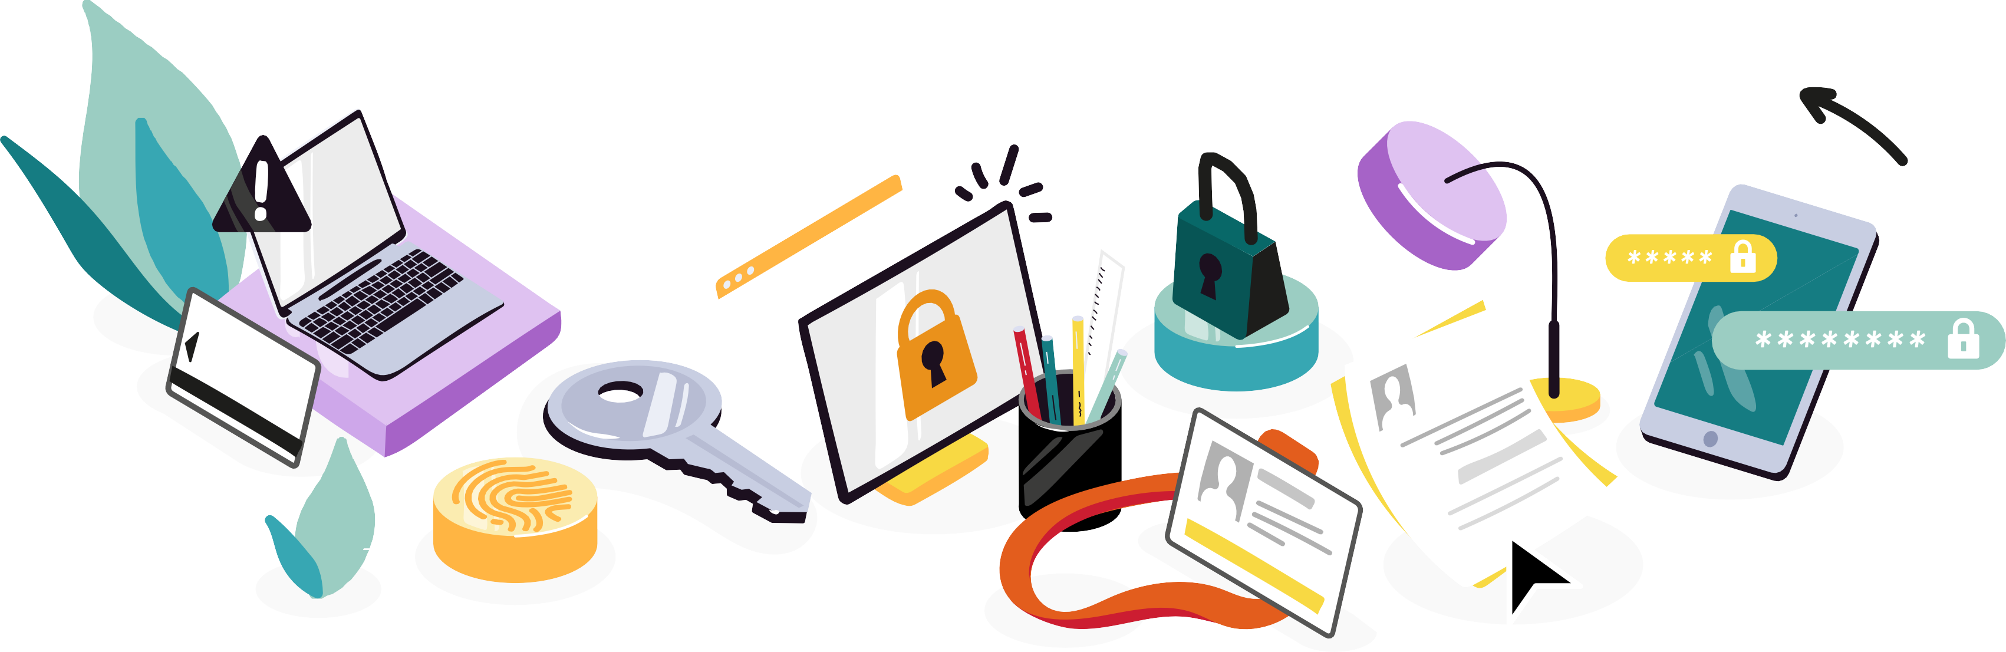
CYBERSECURITY, MY FUTURE CAREER
!
Facilitator's Guide
CB
CV
$ +
+
€

Slide 2


SUMMARY
AN INITIATION
TO CYBERSECURITY IN 3 SEQUENCES
This educational kit includes
three sequences, each composed of several activities.
3 BEFORE YOU BEGIN
⁶ CYBERSECURITY PROFESSIONS
ACTIVITY 1: THE GESTURES OF CYBER
ACTIVITY 2: I AM NOT A HACKER AND YET I WORK IN CYBERSECURITY!
ACTIVITY 3: CYBER: ONE OR MORE PROFESSIONS?
BEWARE OF APPEARANCES!
ACTIVITY 1: AVOID FAKE TECH SUPPORT SCAMS ACTIVITY 2: DON'T LET CYBERCRIMINALS STEAL FROM YOU!
ACTIVITY 3: SPOT DEEPFAKE CONTENT
PROTECT YOUR ONLINE ACCOUNTS!
ACTIVITY 1: A GOOD PASSWORD IS YOUR FIRST LINE OF DEFENSE!
ACTIVITY 2: PROTECT YOUR MOST IMPORTANT ONLINE ACCOUNTS
ACTIVITY 3: INTERVIEW YOUR CYBER-AI COACH
CONCLUSION
The sequences are independent of each other and can be made according to your needs.
26
HOW TO USE THIS KIT?
It's up to you to adapt the language to those you want to convince and to choose the words that suit young people by adapting to their concerns!
55
73

Slide 3
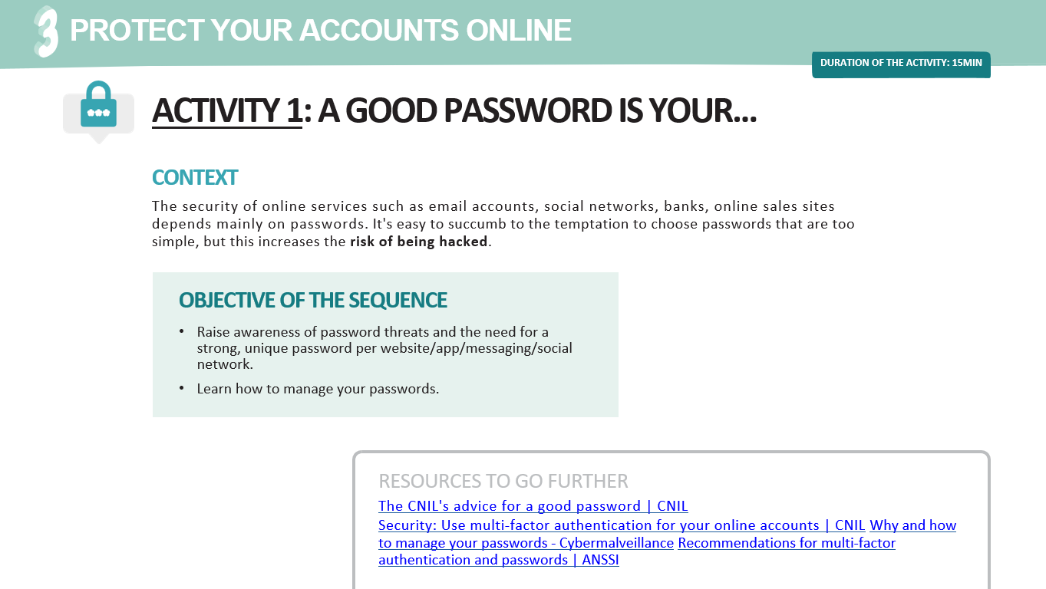
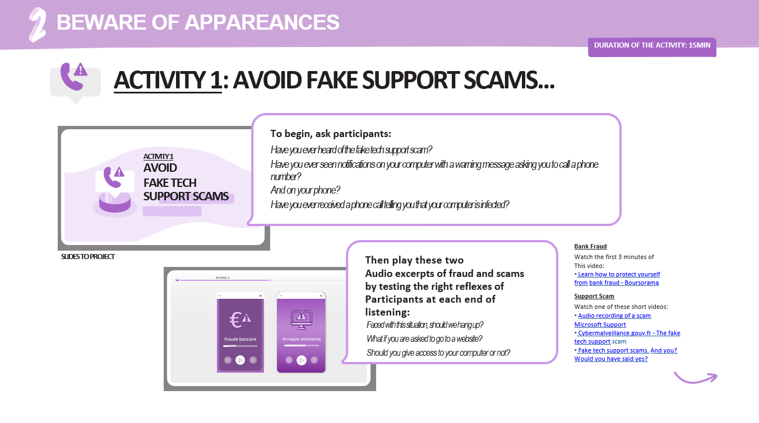
BEFORE YOU BEGIN
Get the PDF "Participant Guide" to discover the slides to project during your presentation. Check that you will have a screen or a video projector available.
Follow the steps step by step and use the instructions to comment on the slides to be projected as you go.
Background and resources are available to help you delve deeper into the topic and answer questions from participants.

Slide 4


BEFORE YOU BEGIN
Make sure you have enough time to complete the sequences you are interested in (approximate duration).
60 min
60 min
30 min
CYBERSECURITY PROFESSIONS
Discover the diversity of professions
BEWARE OF APPEARANCES
Be vigilant against
online scams
PROTECT YOUR ONLINE ACCOUNTS
Learn how to manage passwords

Slide 5
BEFORE YOU BEGIN
Some golden rules of facilitation for a serene intervention:
DISTRIBUTE THE FLOOR WELL AMONG THE PARTICIPANTS
ENSURE THAT THE OBJECTIVES ARE WELL UNDERSTOOD AT THE END OF EACH SEQUENCE
CONCLUDE BY SUMMARIZING THE IMPORTANT POINTS

Slide 6
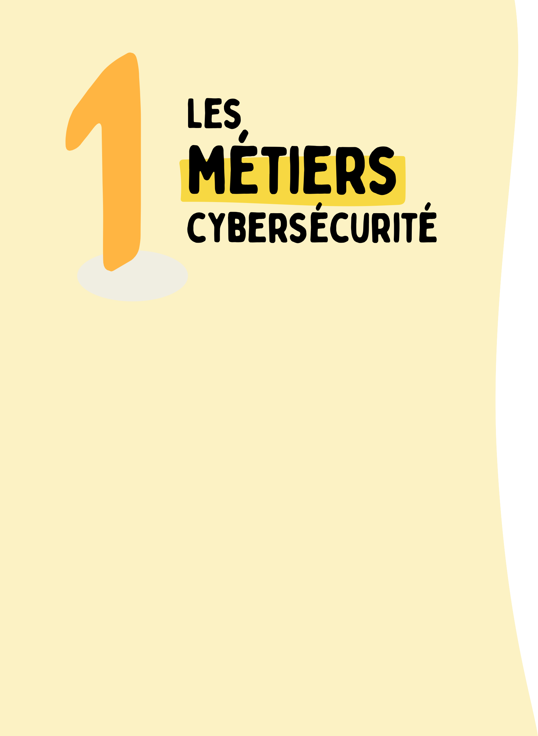
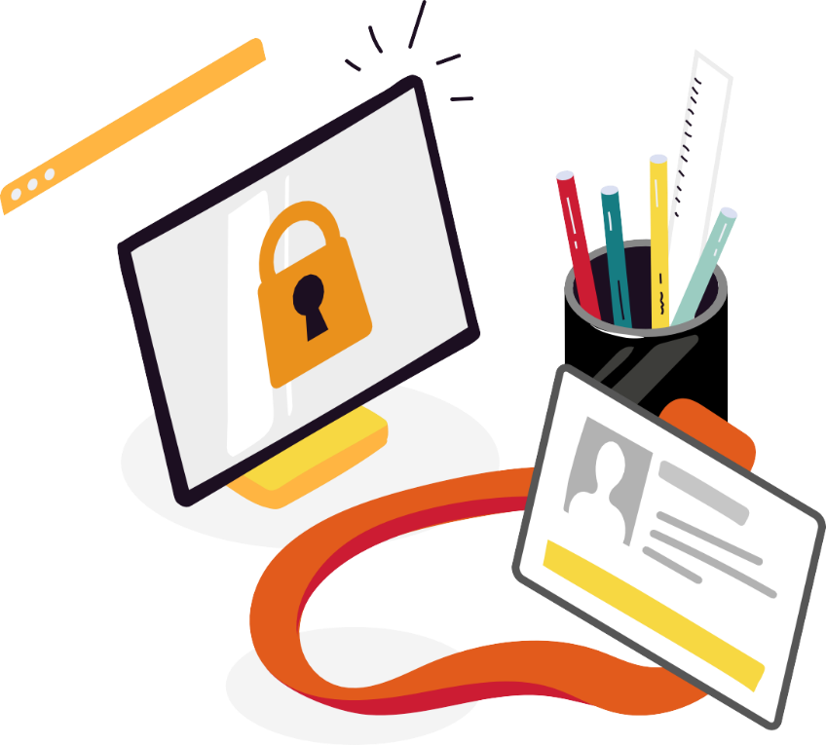
CONTEXT
CAREER IN CYBERSECURITY
Discover the diversity of professions
There is a shortage of talent in the field of cybersecurity with 60,000 positions to be filled in France and, more generally, several million positions without candidates worldwide.
It is difficult to give an exhaustive list of the qualities required to work in the field of cybersecurity because the positions to be filled are very varied. However, the following qualities are generally observed: a good knowledge of
digital technologies, good analytical and critical thinking skills and intellectual curiosity.
The profiles sought are varied: no need to be good at maths or a computer geek, but for those who are, there are of course very technical jobs – everyone can find their way around / no divide. Math and programming are useful in the field of cybersecurity, but they are not a necessity.
CV
Cybersecurity jobs are jobs that make sense:
These jobs are important because they allow you to help others protect themselves from malicious people, participate in the development of technologies that will contribute to the protection of health (avoid blocking hospitals for example), allow access to reliable information (by removing fake news) or raise awareness of cybersecurity gestures.
The sectors of activity are limitless. You can choose to protect a private company or a public organization.
Cybersecurity also opens up to international mobility because the profession is borderless. We can work on all continents.
Cybersecurity jobs cover a wide range of skills. Among the most common jobs are the ethical hacker, the cybersecurity consultant, the security incident analyst or the Information Systems Security Manager (CISO), but also the jobs of salespeople, cyber project managers or marketing managers.
There are many recruitment opportunities with an attractive salary (higher than average) and career development (evolution towards different positions throughout one's professional life, etc.).

Slide 7
ACTIVITIES
CAREER IN CYBERSECURITY
ACTIVITY 1: THE GESTURES OF CYBER
Practice recognizing good cybersecurity practices.
ACTIVITY 2: I AM NOT A HACKER AND YET I WORK IN CYBERSECURITY!
Challenging certain prejudices about jobs
cybersecurity.
ACTIVITY 3: CYBER, ONE OR MORE PROFESSIONS?
Discover some jobs in cybersecurity.
OBJECTIVE OF THE SEQUENCE
This sequence encourages
participants to explore the diversity of cybersecurity professions, invites them to familiarize themselves with the vocabulary of the professions and finally aims to shake up preconceived ideas.
At the end of this sequence,
Participants will be able to:
Name some cybersecurity jobs
Measuring the meaning and challenges of these professions

Slide 8

CAREER IN CYBERSECURITY
To start, as an icebreaker, ask participants what they know about cybersecurity using these examples:
Do you know people working in this field? What are the different jobs in cybersecurity?
What does success mean to you?
Do you make a lot of money working in cybersecurity? Why work in cybersecurity?
Do you have to be good at maths to work in cybersecurity? Do you have to be a geek to work in cybersecurity?
What are the qualities to work in the field of cybersecurity?
THE
TRADES
CYBERSECURITY
CV
SLIDE TO PROJECT

Slide 9


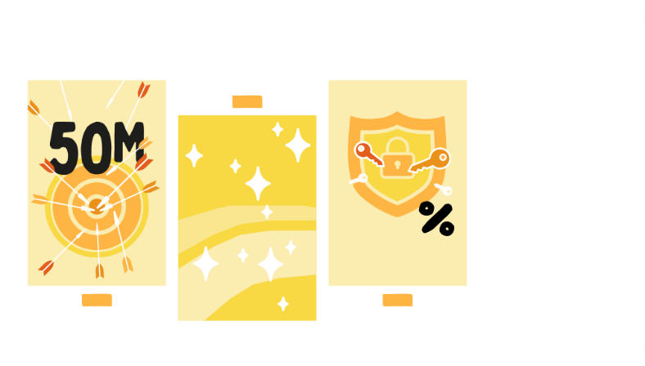
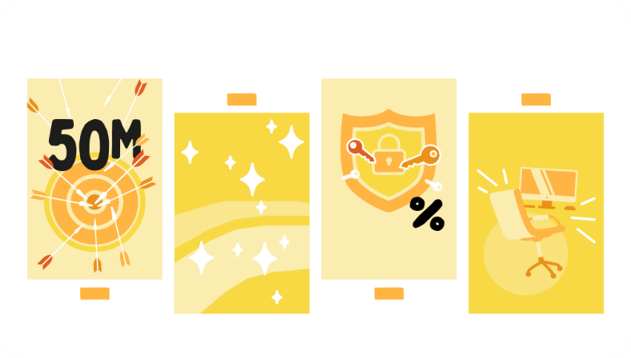
CAREER IN CYBERSECURITY
Review the 4 key figures illustrated.
To go further, here are some others:
In 2020, the average cost of a malware attack for a business was more than $2.5 million. This includes the cost of the time it takes to resolve the attack, which is 50 days on average. (source)
In the second quarter of 2020, the average ransom demanded was over $100,000, and it continues to increase over time. (source)
The average total cost of a data theft increased by nearly 10% between 2020 and 2021: a level not seen in 7 years. The global average total cost of a data breach in 2021 was $4.24 million. (source)
The average total cost of an information theft caused by the compromise of a business mailbox is $5.01 million. (source)
Cybercrime is expected to cost the world $10.5 trillion a year by 2025, up from $3 trillion a decade ago and $6 trillion in 2021. (source)
WHY DOES CYBERSECURITY CONCERN US ALL?
THE PIRATES
launch on average
Why cybersecurity will affect us all and
Source Hackers
launch on average
93% of attacks
of all incidents
_{on security passwords} would have
every day, could be avoided
579^{/second} if
Cyber hygiene
basic source had been put in place
E?
attack
Why cybersecurity will affect us all and
Source hackers ^{use}
on average initiate authentication
93% of attacks
multifactor
(MFA)
99.9
Blocks
of all incidents
_{on security passwords} would have
every day, could be avoided
579^{/second} if attack rules
Cyber hygiene
basic source had been put in place
E?
on passwords
Why cybersecurity is relevant to all of us and
Source Pirates ^{Source Use}
on average initiate authentication
Attack rateS 93% 150
multifactor _{there is}
(MFA)
99.9
Blocks
of all incidents
_{on security passwords} would have
every day, either ^{be} avoided _{open posts}
579^{/second} if there are rules for attacks in the sector
Cyber hygiene Cyber Security
source in _{francs}
us?
₅₇₉/second
spring
every day, either
00
Rts
r of the
Integrity
e
SLIDES TO PROJECT

Slide 10
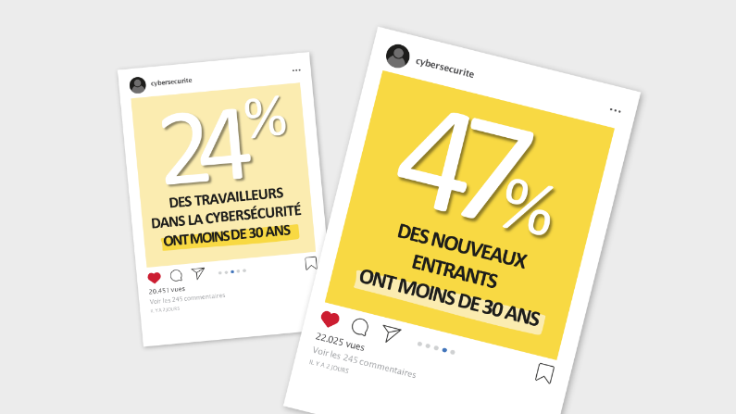
CAREER IN CYBERSECURITY
Explain to participants that this is a dynamic sector. (source ANSSI / Cybersecurity profiles - Survey 2021)
To find out more about this sector, see also the results of the 2023 survey of the ANSSI Observatory of Professions: https://cyber.gouv.fr/publications/lattractivite-des-metiers-de-la-cybersecurite-vues-par-les-professionnels
SLIDE TO PROJECT
LET'S MOVE ON NOW
TO ACTIVITIES

Slide 11


ACTIVITY 1: THE GESTURES OF CYBER
CAREER IN CYBERSECURITY
DURATION OF THE ACTIVITY: 15MIN
CONTEXT
Cyberattackers often choose the easiest attacks to carry out.
For example, a thief will choose to enter a home through a window that is easy to open rather than through an armored door with a surveillance system. The same is true in the digital world. The more basic security measures are in place, the lower the risk of cyberattacks.
OBJECTIVE OF THE SEQUENCE
Practice recognizing good cybersecurity practices.
RESOURCES TO GO FURTHER
2021 Activity Report - Cybercrime
ANSSI MOOC

Slide 12

ACTIVITY 1: THE GESTURES OF CYBER
CAREER IN CYBERSECURITY
DURATION OF THE ACTIVITY: 15MIN
To begin, ask participants:
Does a padlock in the browser mean that the site is secure?
Is it riskier to surf with a computer or with a smartphone?
ACTIVITY 1
THE GESTURES OF CYBER
Then, propose the quiz "Good idea or not?" after explaining the context:
At the end of 2021, 92% of households in France had an internet connection, and you spend an average of 3 hours and 53 minutes every day surfing the internet! (15-24 years old / Médiamétrie 2021)!
ACTIVITY 1
SLIDE S TO PROJECT
GOOD IDEA OR NOT?

Slide 13
ACTIVITY 1: THE GESTURES OF CYBER
CAREER IN CYBERSECURITY
DURATION OF THE ACTIVITY: 15MIN
Activity 1
Each service should have a different password to avoid the risk of a cascading compromise.
Activity 1
A padlock in the address bar does not mean that the site is secure. If in doubt, access the website is preferred by typing the address directly into the search bar. Otherwise, you risk leaking your password to a fraudster.
Do you think that a good password can be used for several services (mailboxes, social networks, banking, e-commerce sites, administrations, etc.) ?
_{A} Yes, when the services have nothing to do with each other
You receive an email informing you that photos where you are tagged are available. The website asks you to enter your Facebook ID and password. It appears that the website has a legitimate certificate with a padlock next to the address bar.
You enter your username and password on the website.
Is this a good idea or not?
_{A} Yes
_{B} Yes, but only if the password contains
Special characters
B
No
_{C} No, each department must have a different password
Never click on a link or attachment that seems questionable about its origin or nature. If in doubt, access the website is preferred by typing the address directly into the search bar.
Activity 1
Activity 1
Fake error messages are usually generated by a malicious or compromised website. These pop-ups may appear to block access to your computer, but restarting your computer may be enough to fix the problem.
You receive an email about the closure of your Instagram account. This email contains the Instagram logo and has an attachment. You:
_{A} Open the attachment to learn more
What should you do if a message appears blocking your computer, indicating a serious technical problem, a risk of losing your data or the presence of many viruses?
_{Doing} nothing
_{B} Hesitate to open the attachment but are reassured
_{B} Contact technical support at the number listed
by the Instagram logo
on the error message
_{C} Do not open the attachment and log in
_{C} Try to restart your computer and, if the problem
directly to your account
persists, asking a friend for help
Activity 1
Be careful of messages that seem urgent. If you had ordered something, you would have already entered your postal address. Do not click on these messages or dial the number provided.
Activity 1
You receive an SMS telling you that your package is arriving but that you need to update your delivery details. You:
You are at the airport before boarding your flight. You have run out of battery on your phone. There are public computers available for passengers to browse the Internet. You want to pass the time and go to your favorite social network.
You launch a browser in private mode, then authenticate
with your password to access your profile.
Is it safe?
_{A} Yes
_{B} No
It's risky to log in to your online accounts from a device that you don't own. Keys typed on the keyboard could be recorded or malware could steal your authentication secrets.
_{A} Tap the link in the SMS
_{B} Do nothing
_{C} Call the sender's phone number

Slide 14


ACTIVITY 1: THE GESTURES OF CYBER
CAREER IN CYBERSECURITY
DURATION OF THE ACTIVITY: 15MIN
Discover the guide to good IT practices published by the ANSSI and the CPME for small and medium-sized companies, the 9 rules of which can also be applied to individuals. This is called digital hygiene.
Activity 1
FOR GOOD DIGITAL HYGIENE
Resource to read to go further
Choose your passwords carefully
Regularly update and patch devices
Make backups of your data regularly
Secure access to your Wi-Fi
Be as careful with your smartphone or tablet as you are with your computer
Be careful when using your email Download your programs from the official websites of the
Publishers
Take stock of a gesture to remember to protect
Be vigilant when paying on the Internet
physical access to their devices.
Take care of your personal information,
and its digital identity
Activity
1
SLIDE S TO PROJECT
A GESTURE TO REMEMBER:
GET INTO THE HABIT OF LOCKING THE SCREEN OF YOUR DEVICES WHEN YOU WALK AWAY FROM THEM
TO PREVENT UNAUTHORIZED ACCESS, INCLUDING LOSS OR THEFT.

Slide 15
ACTIVITY 2: I'M NOT A HACKER AND YET...
CAREER IN CYBERSECURITY
DURATION OF THE ACTIVITY: 30MIN
CONTEXT
The field of cybersecurity suffers from an image deficit where the expert is a solitary, geek-type person who seems to be a little computer genius who spends his time behind his screen coding to get through security systems. The testimony of a cybersecurity professional and a quiz are there to shake up these preconceived ideas.
OBJECTIVE OF THE SEQUENCE
Challenging certain biases
on cybersecurity professions.
RESOURCE FOR FURTHER
Padlet – Cyber, my future job!

Slide 16

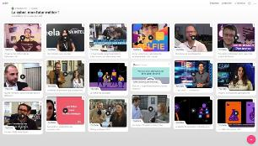
ACTIVITY 2: I'M NOT A HACKER AND YET...
CAREER IN CYBERSECURITY
DURATION OF THE ACTIVITY: 30MIN
If you are a cybersecurity professional, share your own story and your journey using the questions on the slide or these:
What's your job?
What does the job consist of? What are the different tasks performed?
ACTIVITY 2
I'M NOT A HACKER
AND P
OURTANT I WORK ON CYBERSECURITY
How big is your company?
IN
ACTIVITY 2
What are the workplaces? Do you travel often?
WHAT DOES YOUR JOB CONSIST OF?
What tools do you need for your job?
How did you get into cybersecurity?
How did you get into cybersecurity?
What do you like about your job?
SLIDE S TO PROJECT
What do you like about your job?
What does a typical day look like in cybersecurity?
Do you need to know how to speak English to do your job?
Have you ever been a victim of a virus or phishing?
What are your three cybersecurity tips?
What would you say to young people who are hesitant to get into cybersecurity?
Have you ever been a victim of a virus or phishing?
What are your three cybersecurity tips?
You can present some video testimonials and comment on the different characteristics of the jobs presented (sense of commitment, learning to learn, collaboration) thanks to the
Padlet – Cyber, my future job!
You can also illustrate how the different
cybersecurity professions collaborate.

Slide 17


ACTIVITY 2: I'M NOT A HACKER AND YET...
CAREER IN CYBERSECURITY
DURATION OF THE ACTIVITY: 30MIN
Activity 2
True or false?
Cybersecurity means being good at math
Then, propose the quiz "Shaking up preconceived ideas about jobs
SHAKING UP PRECONCEIVED IDEAS
of cybersecurity". For each statement, the participants
Activity 2
True or false?
Cybersecurity means being good at math
answer with "True" or "False" in order to discover the correct answer.
ON THE PROFESSIONS
CYBERSECURITY
Activity 2
Take stock of the main takeaway from the
cyber professions.
SLIDE S TO PROJECT
TO REMEMBER:
CYBERSECURITY IS WITHIN EVERYONE'S REACH!

Slide 18
ACTIVITY 3: CYBER: ONE OR MORE PROFESSIONS?
CAREER IN CYBERSECURITY
DURATION OF THE ACTIVITY: 15MIN
CONTEXT
Cybersecurity needs are increasing as businesses become more reliant on information and communication technology. Organizations face increasing risks of data leakage, fraud, hacking, and intrusion. Cybersecurity professionals have an important role
to help organizations protect their digital assets (data,
computers and networks).
OBJECTIVE OF THE SEQUENCE
Discover some jobs in cybersecurity.
Discover several study paths.
RESOURCES TO GO FURTHER
Overview of cybersecurity professions - ANSSI Mapping of cybersecurity professions - EGE Cybersecurity professions – Guardia School

Slide 19

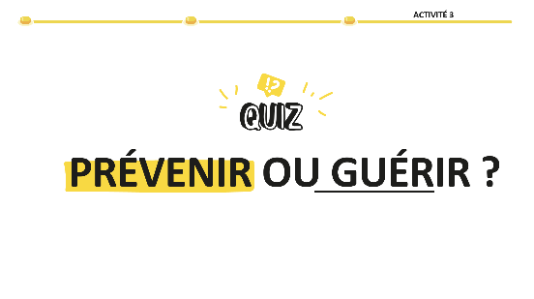


ACTIVITY 3: CYBER: ONE OR MORE PROFESSIONS?
CAREER IN CYBERSECURITY
DURATION OF THE ACTIVITY: 15MIN
prevent
Search | Design Raise Awareness | Administer
Activity 3
The ethical hacker conducts security assessments
heal
React | Investigate Improve | Reconstruct
IT environments, identifies vulnerabilities and
ETHICAL HACKER
proposes remedial actions. It can achieve different
types of audits according to its scope of activity (tests
, code audit, configuration review, etc.).
Then, propose the game "Prevention or cure ?". For each job proposal, the participants divide it into the two categories: prevention or cure.
The cybersecurity consultant provides solutions to the issues
prevent
Search | Design Raise Awareness | Administer
Activity 3
by mobilizing its expertise and experience. It can
heal
React | Investigate Improve | Reconstruct
contribute to the definition of the
ethical hacker
the organization and implementation of cybersecurity solutions.
CONSULTANT
CYBERSECURITY
A cybersecurity consultant's main role is to prevent
attacks by helping customers implement
security. He can also intervene in a reactive manner and help customers
Identify and fix vulnerabilities after an attack.
prevent
Search | Design Raise Awareness | Administer
ethical hacker
Cybersecurity Consultant
Activity 3
heal
React | Investigate Improve | Reconstruct
Cybersecurity Consultant
In the event of suspicion of malicious activity or an attack, the analyst
Security incident response analyzes symptoms, performs
ANALYST RESPONSE
SECURITY INCIDENTS
technical investigations and identifies the operating method of
the striker. It qualifies the extent of the compromise and provides
recommendations for remediation.
(According to the grouping of the name "Prevention and Cure", from the book:
Envie de Cyber, ISSA France Security Tuesday, Ed. Studyrama)

Slide 20
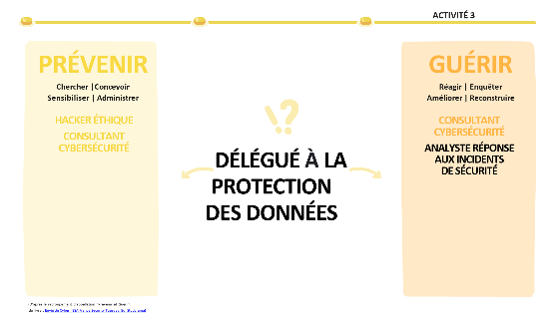



ACTIVITY 3: CYBER: ONE OR MORE PROFESSIONS?
CAREER IN CYBERSECURITY
DURATION OF THE ACTIVITY: 15MIN
prevent
Search | Design Raise Awareness | Administer
ethical hacker
Cybersecurity Consultant
Cybersecurity Architect
Cryptologist
heal
React | Investigate Improve | Reconstruct
Cybersecurity Consultant
Security Incident Response Analyst
Cybersecurity Architect
Cybersecurity Crisis Manager
The Security Solutions Administrator is responsible for
The Data Protection Officer (DPO) ensures that personal data processing practices comply with the legislation in force. He advises and guides the organization to ensure the security and confidentiality of personal information
installation, management and operation of
SECURITY SOLUTIONS ADMINISTRATOR
security. It must ensure the proper functioning of the
safety by ensuring that safety conditions are maintained.
Activity 3
The cybersecurity trainer is responsible for training and/or
prevent
Search | Design Raise Awareness | Administer
Activity 3
prevent
Search | Design Raise Awareness | Administer
ethical hacker
Cybersecurity Consultant
Cybersecurity Architect
Cryptologist
Security Solutions Administrator
heal
React | Investigate Improve | Reconstruct
Cybersecurity Consultant
Security Incident Response Analyst
Cybersecurity Architect
Cybersecurity Crisis Manager
or raising awareness of regulatory and technical aspects
heal
React | Investigate Improve | Reconstruct
or operational cybersecurity operations. He develops
ethical hacker
Cybersecurity Consultant
Cybersecurity Architect
Cybersecurity Consultant
Security Incident Response Analyst
Cybersecurity Architect
The cybersecurity crisis manager often intervenes in a
TRAINER IN
CYBERSECURITY
training tailored to target audiences and illustrates its messages
CRISIS MANAGER
CYBERSECURITY
team dedicated to crisis management. He analyses the extent of the crisis, puts
through practical work, demonstrations or exercises
in place the actions necessary to resolve it and coordinate the teams
Participatory. It can assess the level of knowledge before and
to implement its recommendations. He advises the management
after the training.
business lines to solve cybersecurity crises. He organizes the
Ability of the organization to respond to new
cybersecurity.
Activity 3
Activity 3
prevent
Search | Design Raise Awareness | Administer
ethical hacker
Cybersecurity Consultant
Cybersecurity Architect
Cryptologist
Security Solutions Administrator
Cybersecurity Trainer
heal
React | Investigate Improve | Reconstruct
Cybersecurity Consultant
Security Incident Response Analyst
Cybersecurity Architect
Cybersecurity Crisis Manager
prevent
Search | Design Raise Awareness | Administer
ethical hacker
Cybersecurity Consultant
Cybersecurity Architect
heal
React | Investigate Improve | Reconstruct
Cybersecurity Consultant
Security Incident Response Analyst
Cybersecurity Architect
Cybersecurity Crisis Manager
The CISO is responsible for cybersecurity within
CISO
(INFORMATION SYSTEMS SECURITY OFFICER)
organization. It defines the security policy of the systems
CRYPTOLOGIST
The cryptologist is an expert in cryptography who helps to ensure the
information, advises business managers, implements
confidentiality, integrity and authenticity of data. The cryptologist
security solutions and manages security teams.
intervenes in private or public research laboratories.
(According to the grouping of the name "Prevention and Cure", from the book:
Envie de Cyber, ISSA France Security Tuesday, Ed. Studyrama)

Slide 21

CONTEXT
BEWARE OF
APPAREANCES
Fraudsters are everywhere and target everyone: teenagers, grandparents or business leaders. Online scams can take many forms, but their goal is always the same: to steal your passwords, personal data, bank details, access to your devices and online accounts.
It is important to remain vigilant (without becoming
paranoid) by adopting reflexes:
Develop your critical thinking and don't hesitate to ask yourself questions: why is this person sending me an attachment by email? Have I ever visited the site pointed to by the link in this SMS? Why is my friend writing me this weird message? etc.
Use simple gestures such as locking your computer or phone, or avoid typing your credentials on a device that does not belong to you.
Unsolicited calls and messages are one of the main ways fraudsters operate. Fraudsters are persuasive enough to convince you that there is a virus on your computer, that you need to pay a sum of money, that there is fraudulent activity on your bank account. Fraudsters are looking for
Have malware installed, approve a banking transaction or authentication request, disclose personal information, or your password.
CB

Slide 22

ACTIVITIES
BEWARE OF
APPAREANCES
ACTIVITY 1: AVOID FAKE TECH SUPPORT SCAMS
Know how to react and report fake tech support scams
ACTIVITY 2: DON'T LET CYBERCRIMINALS STEAL FROM YOU!
Learn to recognize the signs of a scam
OBJECTIVES OF THE SEQUENCE
This sequence allows participants to learn about common features of online scams and demonstrate their understanding by putting themselves in the shoes of an attacker.
At the end of this sequence,
Participants will be able to:
Recognizing the Signs of a Scam
Explain the different reflexes to have against the most common scams
Raise awareness by telling the story of an online scam

Slide 23

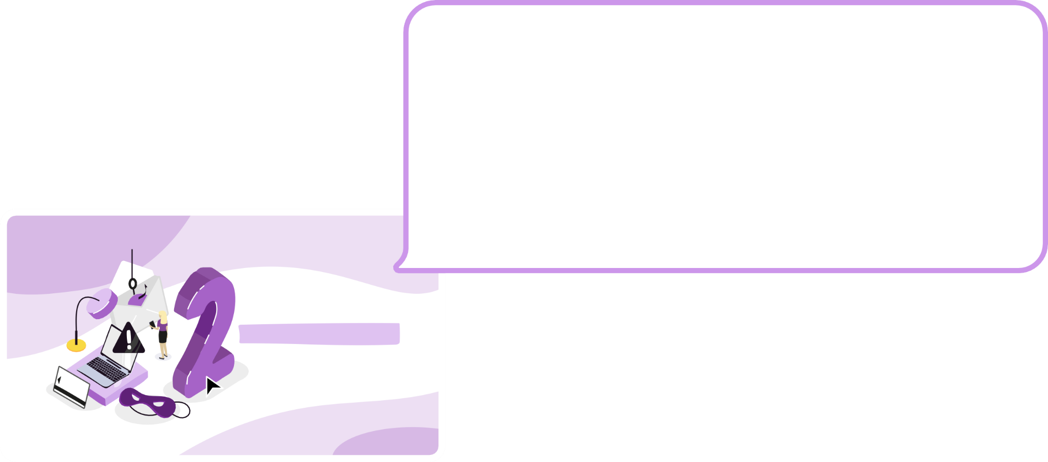
BEWARE OF
APPAREANCES
To start, as an icebreaker, ask participants what they know about online scams and how to spot them using these questions:
What is an online scam?
Why would someone try to scam you online? How do you know if you are facing a scam?
What to do if you think you've been scammed online?
BEWARE OF
APPEARANCES
CB
SLIDE TO PROJECT
LET'S MOVE ON NOW
TO ACTIVITIES

Slide 24

ACTIVITY 1: AVOID FAKE SUPPORT SCAMS...
BEWARE OF APPAREANCES
DURATION OF THE ACTIVITY: 15MIN
CONTEXT
This scam is wreaking havoc on individuals. While browsing the Internet or after clicking on a malicious link, a window appears and freezes your computer. It asks you to urgently call back a technical support number or risk losing access to your data or the use of your computer.
Once contacted, the pseudo technical service asks you to access your terminal remotely and charges for a fake repair while making you buy useless, even dangerous software.
OBJECTIVE OF THE SEQUENCE
Know how to react and report fake tech support scams.
RESOURCES TO GO FURTHER
How to deal with fake tech support scam? -Cybercrime
Fake Technical Support Scam Fact Sheet – Cybermalicilance Protect yourself from tech support scams (microsoft.com)

Slide 25
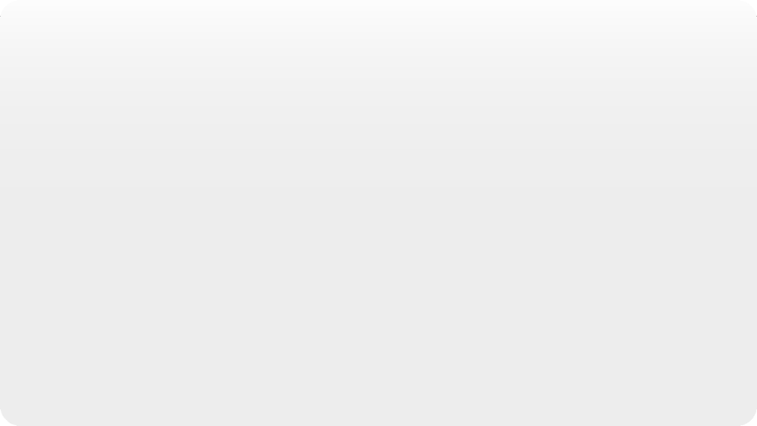









BEWARE OF APPAREANCES
DURATION OF THE ACTIVITY: 15MIN
ACTIVITY 1: AVOID FAKE SUPPORT SCAMS...
To begin, ask participants:
Have you ever heard of the fake tech support scam?
Have you ever seen notifications on your computer with a warning message asking you to call a phone number?
And on your phone?
Have you ever received a phone call telling you that your computer is infected?
ACTIVITY 1
AVOID
FAKE TECH SUPPORT SCAMS
Bank Fraud
Watch the first 3 minutes of
This video:
Learn how to protect yourself from bank fraud - Boursorama
Support Scam
Watch one of these short videos:
Audio recording of a scam
Microsoft Support
Cybermalveillance.gouv.fr - The fake tech support scam
Fake tech support scams. And you? Would you have said yes?
SLIDES TO PROJECT
Then play these two
Audio excerpts of fraud and scams
Activity 1
by testing the right reflexes of
Participants at each end of listening:
Faced with this situation, should we hang up?
What if you are asked to go to a website?
Should you give access to your computer or not?

Slide 26









BEWARE OF APPAREANCES
DURATION OF THE ACTIVITY: 15MIN
ACTIVITY 1: AVOID FAKE SUPPORT SCAMS...
Summarize the principle of fake tech support scams:
An expert calls you. He claims to work for a well-known company, and tells you that your computer
has been infected with a virus. According to him, the only solution is to give him remote access to your computer so that he can repair it directly. It may also attempt to sell you a so-called antivirus. Under pressure, it may seem logical to do what he asks, but beware: it's a scam!
Fraudsters call people randomly, pretending to be legitimate experts. They try to scare you into giving them money or giving them control of your computer by downloading fake software or giving them your passwords. It is important not to give in to the demands of these fraudsters and ignore them.
This scam also takes the form of pop-up messages that appear on your screen, alerting you that your computer has been infected.
Even though the calls and pop-ups are compelling, in reality you risk having your credit card codes and banking credentials stolen, losing access to your computer, becoming a victim of identity theft, and even having your bank account emptied. Do not call the numbers that appear directly in the warning messages.
Activity 1
SLIDE TO PROJECT
Still taking the example of these 2 cases of scams, explain the first reflexes to have to thwart them:
If someone calls you to verify your personal details as a result of suspicious transactions, or because a transaction needs to be reversed after verifying your identity, don't talk any longer and hang up right away. This person is probably a fraudster who is trying to get you to validate a financial transaction or a connection to your account.

Slide 27
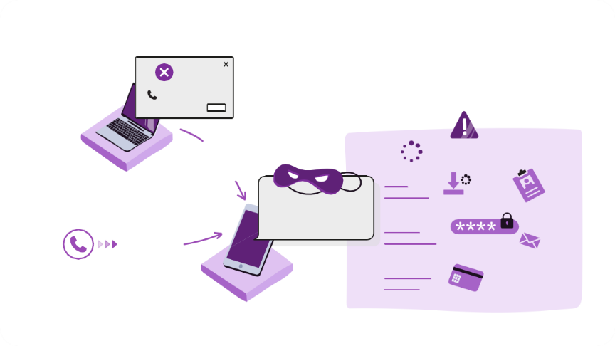
BEWARE OF APPAREANCES
DURATION OF THE ACTIVITY: 15MIN
ACTIVITY 1: AVOID FAKE SUPPORT SCAMS...
To explain how the scam happens, tell this story using the infographic:
During this attack, the scammer contacts you and tries to convince you that there is a problem on your computer and that you should let them "fix" it for you.
ACTIVITY 1
The two most common ways it uses to contact you are by sending you fake error messages
FAKE ERROR MESSAGE
VIRUS
CALL QUICKLY!
on your computer or call you on your phone.
O1 86 76 09
OK
CALLING THE NUMBER
MEANWHILE...
Fake error messages are usually generated by a malicious or compromised website. You use
OR
COMPUTER ACCESS
LOADING VIRUS
INFO
just your web browser. For example, you click on a link in a web or network search
"LEAVE IT TO ME, I'LL SOLVE YOUR PROBLEM..."
REQUEST PERSONAL INFORMATION
NAME
and then your screen suddenly displays worrying messages informing you that your computer is experiencing a
INCOMING CALL
FORENAME
€ +
INVOICING SERVICES
+
€
problem or virus and you should immediately call the phone number provided. These pop-ups
may appear to block access to your computer, so you can't close them. Recorded sounds or voices can even accompany these pop-ups to make them even more visible.
SLIDE TO PROJECT
Phone calls usually take the form of a "help desk agent" calling you on behalf of a trusted company such as Microsoft or Amazon. These scammers are professionals and are often quite convincing...

Slide 28
BEWARE OF APPAREANCES
DURATION OF THE ACTIVITY: 15MIN
ACTIVITY 1: AVOID FAKE SUPPORT SCAMS...
It doesn't matter if you call them from a pop-up message or other error message, or if they call you as a help desk agent, the story is always the same. They let you know that they've detected a problem with your computer or account and that they want you to let them fix it.
ACTIVITY 1
Here are some things that usually happen at this stage:
FAKE ERROR MESSAGE
VIRUS
CALL QUICKLY!
The scammer will want you to allow them to remotely access your computer so they can "fix" it. When it claims to repair your computer, it will steal your information or install malware.
They may ask for your personal information in order to help you "correct" your account. This information likely includes things like your name, address, username, password, social security number, date of birth, and any other type of personal or financial data it may trick you into revealing.
They will often try to charge you a fee for their services in order to "fix" the non-existent problem. If you gave them your credit card information, they may not have been able to use it and ask if you have another one. He will try to obtain several bank cards.
They may ask you for the credit card payment verification code that you received via SMS.
O1 86 76 09
OK
CALLING THE NUMBER
MEANWHILE...
OR
COMPUTER ACCESS
LOADING VIRUS
INFO
"LEAVE IT TO ME, I'LL SOLVE YOUR PROBLEM..."
REQUEST PERSONAL INFORMATION
NAME
INCOMING CALL
FORENAME
€ +
INVOICING SERVICES
+
€
SLIDE TO PROJECT

Slide 29
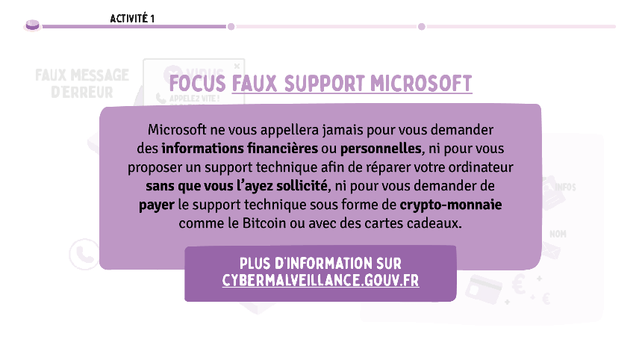
BEWARE OF APPAREANCES
DURATION OF THE ACTIVITY: 15MIN
ACTIVITY 1: AVOID FAKE SUPPORT SCAMS...
Focus on fake Microsoft tech support scams and remind them of these rules:
• Microsoft will never call you to ask for financial or personal information.
• Microsoft will also never call you unsolicited to offer technical support to repair your computer.
• Microsoft will never ask you to pay for technical support in the form of cryptocurrency like Bitcoin, or with gift cards.
If you see an error message or pop-up window with a phone number, don't call it. Microsoft's error and warning messages never include a phone number.
If you've been contacted by someone claiming to be from Microsoft or associated with Microsoft and you think it's a scam, report the incident through the Microsoft online reporting tool "Report support fraud": https://www.microsoft.com/fr-fr/concern/scam?rtc=1
If you are a victim of a fake tech support scam, follow the steps on the cybermalveillance.gouv.fr site: https://www.cybermalveillance.gouv.fr/tous-nos-contenus/fiches-reflexes/arnaques-au-faux-support-technique
SLIDE TO PROJECT

Slide 30

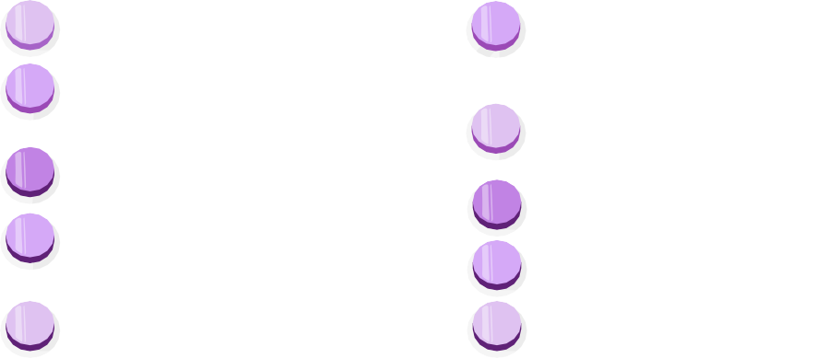
BEWARE OF APPAREANCES
DURATION OF THE ACTIVITY: 15MIN
ACTIVITY 1: AVOID FAKE SUPPORT SCAMS...
Review what to do if you get a call or if you get a pseudo error message:
Hang up: Most real software companies won't call you to tell you that your
ACTIVITY 1
computer is compromised. If you are called, it is false.
WHAT TO DO IF SOMEONE CALLS YOU
OR IF A PSEUDO ERROR MESSAGE IS DISPLAYED?
Do not manipulate your device: hang up if you are asked by phone to make
manipulations on your computer.
HANG
DO NOT MANIPULATE YOUR DEVICE
DON'T COMMUNICATE ANYTHING TO STRANGERS
CALL A GENUINE NUMBER DIRECTLY
6 UPDATE YOUR
WEB BROWSER AND YOUR OPERATING SYSTEM
Don't share anything with strangers: Don't give anyone any information about your accounts (any usernames
or password) or computer information (IP address). You have no guarantee that the person at the
ACTIVATE YOUR BLOCKER
POP-UPS
CLOSE YOUR BROWSER
RESET YOUR DEVICE
SPREAD THE WORD
The end of the line tells you the truth about his identity.
Call a genuine number directly: hang up and call the organization in question using the number
obtained from a reliable source, from the organization's website or on invoices or account statements.
5 PROTECT YOUR COMPUTER
Protect your computer: many products are available to protect your computer: antivirus,
SLIDE TO PROJECT
anti-spyware and firewalls. In some cases, they can be purchased as a software suite. When you do it
Regularly updating them can prevent malware from accessing your computer.

Slide 31
BEWARE OF APPAREANCES
DURATION OF THE ACTIVITY: 15MIN
ACTIVITY 1: AVOID FAKE SUPPORT SCAMS...
Update your web browser and operating system: they both have built-in defenses that are regularly updated to keep up with the latest viruses and other malware. By ensuring that your operating system is updated (e.g., Windows,
ACTIVITY 1
OS X or Ubuntu) and your web browser (e.g., Chrome, Firefox, Edge, or Safari), you can set all the
WHAT TO DO IF SOMEONE CALLS YOU
OR IF A PSEUDO ERROR MESSAGE IS DISPLAYED?
chances on your side.
Turn on your pop-up blocker: Most web browsers have a
HANG
DO NOT MANIPULATE YOUR DEVICE
DON'T COMMUNICATE ANYTHING TO STRANGERS
CALL A GENUINE NUMBER DIRECTLY
6 UPDATE YOUR
WEB BROWSER AND YOUR OPERATING SYSTEM
Built-in pop-ups that prevent pop-ups from appearing on your screen. This could help you
protect from fraudulent pop-ups.
ACTIVATE YOUR BLOCKER
POP-UPS
CLOSE YOUR BROWSER
RESET YOUR DEVICE
SPREAD THE WORD
Close your browser: If your screen suddenly fills up with scary messages, close immediately
your browser (try pressing Alt+F4 if you can't do it with the mouse). If you can't
Close your browser, try restarting your computer.
5 PROTECT YOUR COMPUTER
Reset your device: If you've granted scammers access to your computer, you can try to get them
reset.
SLIDE TO PROJECT
Talk about it around you: share your experience to make those around you aware of this threat. And if you
have paid, contact your bank and file a complaint.

Slide 32

BEWARE OF APPAREANCES
DURATION OF THE ACTIVITY: 15MIN
ACTIVITY 1: AVOID FAKE SUPPORT SCAMS...
ACTIVITY 1
TO REMEMBER:
REPORT
SCAMS, THANKS TO THE THESEE SYSTEM AND THE
GUIDED CHOICE FORM AVAILABLE ON SERVICE-PUBLIC.FR
Take stock of the actions to remember to avoid scams.
DON'T CLICK ON MESSAGES
URGENT ISSUES THAT APPEAR
WHILE YOU'RE BROWSING ONLINE AND DON'T DIAL THE NUMBER
ABUNDANT
HANG
IF YOU ARE ASKED TO MAKE
MANIPULATIONS ON YOUR COMPUTER
IF YOU ARE FACED WITH A SCAM,
TELL A FRIEND, COLLEAGUE OR A FRIEND.
FAMILY MEMBER TO RAISE AWARENESS
TO THIS THREAT
NEVER INSTALL AN APP AT THE REQUEST OF SOMEONE YOU DON'T KNOW
SLIDE TO PROJECT

Slide 33
ACTIVITY 2: DON'T LET CYBERCRIMINALS...
BEWARE OF APPAREANCES
DURATION OF THE ACTIVITY: 45MIN
CONTEXT
The topics of online scams are constantly renewed, but their operation often remains the same: you are sent false information and asked to click on a link to solve a situation that does not exist.
There are many examples:
You receive an SMS or email from a trusted sender inviting you to click on a link to update your account, frank a parcel or receive money.
Someone will contact you by phone or text message to offer you training based on your rights and offer to help you create your account.
An email tells you that your webcam has been hacked, your browsing on pornographic sites has been recorded and, of course, a list of all your contacts and passwords has been collected.
All this is false!
OBJECTIVE OF THE SEQUENCE: Learn to recognize the signs of a scam.
RESOURCES TO GO FURTHER
The scourge of phishing in four examples | Youtube Phishing: Detecting a malicious message | CNIL
What to do in case of phishing? | Cybercrime

Slide 34
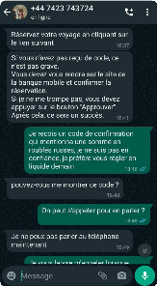
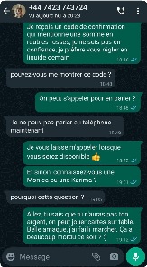
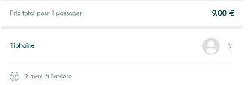
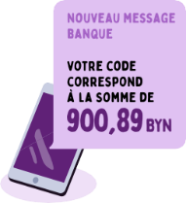
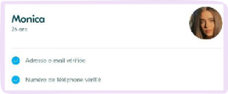
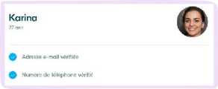
BEWARE OF APPAREANCES
DURATION OF THE ACTIVITY: 45MIN
ACTIVITY 2: DON'T LET CYBERCRIMINALS...
To begin, ask participants:
Have you ever received suspicious messages by email or SMS?
ACTIVITY 2
DON'T LET
CYBERCRIMINALS STEAL FROM YOU
Do you know someone who has ever been a victim of phishing?
What can be the consequences if you click on a link contained in a suspicious message?
What can make you want to click on a link?
Activity 2
SLIDES TO PROJECT
FRAUD TESTIMONIAL VIA BLABLACAR
Activity 2
At the next step, I am contacted Sophia again to tell her ask to enter the code that I prefer to pay her in cash I received by SMS to validate because I am not confident, the payment, a security mentioning the rubles. She has become quite usual asks me for the code, but I do today. But that's where I'm not that gullible
that it's getting juicy: in my SMS my bank tells me that the code in question corresponds to...
... A payment of 900.89 BYN (Belarusian rubles). Very, very weird.
available in full here
Then, discover Valentin's testimony.
Tonight, I think I almost got
victim of a serious scam on
Activity 2
In the meantime, I decide to look for another Blablacar, and bye bye Karina, I then come across Monica. Image plus I come across some very disturbing details. First of all, I'm blurring but very suspicious too. By the way, the ad notes the route proposed by Karina, which was also quickly deleted after I mentioned her was never noted. I am far from being an expert and I name to "Sophia":
I could be wrong, but as I write a bit about tech and cyber, his photo immediately made me think of the thispersondoesnotexist.com site, where an artificial intelligence creates faces that don't exist. Again I'm not 100% sure, but there are several
^{doubtful elements...} A few clarifications: it was not a literal sense but a phishing attempt (ha in French), a malicious practice that deceives the Internet user to encourage him to use personal data (in this case, code blue). When in doubt, a golden rule to remember: do not click on links sent by strangers.
Yet, even though I already knew the right ones
I was fooled. Stress, fatigue, inattention... He
Blablacar.
I want to tell you this in case you find yourself in the same situation...
CANCELLED
After my Paris/Douai train was cancelled due to the
Naively, I book the ride, and I wait for confirmation. 1h30 later, I receive a first email telling me that Tiphaine has accepted the reservation, then a second one telling me on the contrary that she has
Eunice storms, I decide to turn to Blablacar. I
see a ride for 9 euros (cheap), proposed by "Tiphaine".
On his profile, there are no photos and no notes. You think that's
cancelled the trip, and that I will be refunded.
ladle? You are right.
failure to the onsist mesonnage to icer card s
never
Practices
There are a multitude of factors that can cause us to turn a blind eye to the various alerts and make a mistake.

Slide 35
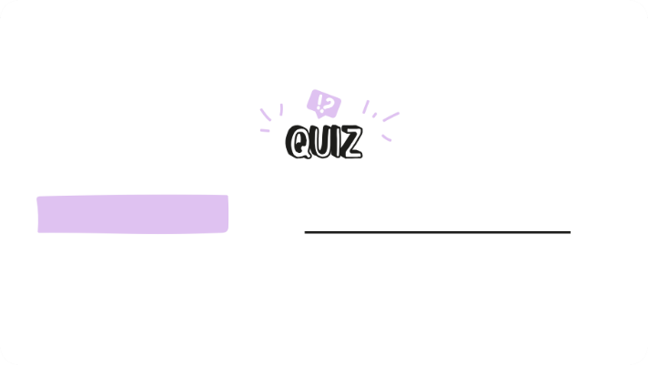
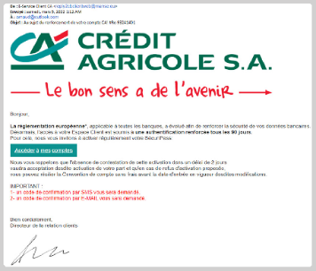
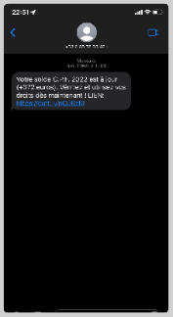

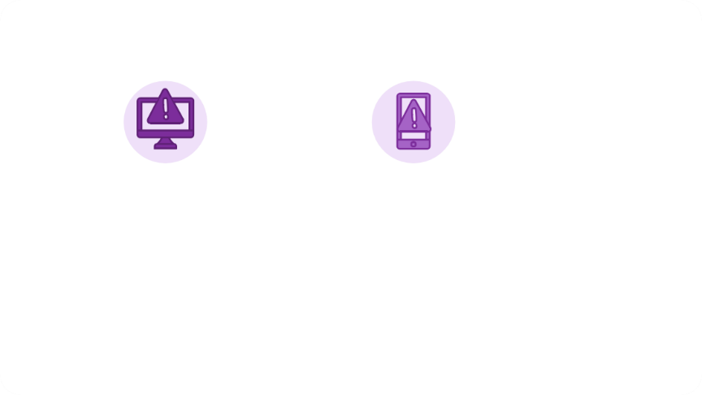
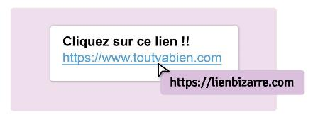
BEWARE OF APPAREANCES
DURATION OF THE ACTIVITY: 45MIN
ACTIVITY 2: DON'T LET CYBERCRIMINALS...
Activity 2
Activity 2
Should you click or not?
How can fraudsters go about making their scam credible? To test the participants, offer the "To click or not to click" quiz. For each
Activity 2
Should you click or not?
No
It is probably a scam. Often, fraudsters use shortened links to make it look like a link looks like it's safe to click.
TO CLICK OR NOT TO CLICK?
affirmation, the participants answer the question "Faced with this message, should we click or not?"
in order to find out the right answer.
Debrief the exercise by explaining the concepts of phishing and smishing:
Phishing is the most common form of scam on the internet.
The fraudster impersonates a known organization or company by using
SLIDES TO PROJECT
Activity 2
the logo and name of this organization. He sends you an email asking you to
confirm your information following a technical incident, such as your contact information
PHISHING
SMISHING
(account number, personal codes, etc.) or your password.
Smishing is a form of SMS phishing on mobile phones. These messages are also very persuasive and ask you to follow a link.

Slide 36

BEWARE OF APPAREANCES
DURATION OF THE ACTIVITY: 45MIN
ACTIVITY 2: DON'T LET CYBERCRIMINALS...
ACTIVITY 2
Just like barcodes, QR codes are images that contain encoded data, such as a link that can redirect to a website or allow an app to be downloaded. Their use has become widespread in recent years due to their practicality, avoiding laborious link entry on mobile devices. However, as with any technological innovation, QR codes have caught the attention of cybercriminals. Incidents such as fake ticket notices left on car windshields or fake QR codes stuck on parking meters have been reported. These fraudulent QR codes, also known as quishing, started making headlines regularly when it comes to cybercrime as early as 2023. Sending malicious QR codes via email may seem suspicious because it requires a second device to scan, reducing the success rate for cybercriminals. Moreover, the physical distribution of QR codes can only target a limited number of potential victims, thus presenting a low return on investment and a high risk of detection for criminals.
While the threat of malicious QR codes is still limited, it remains real, exploiting victims' difficulty in recognizing fraudulent links, especially when they are masked as a QR code. These malicious QR codes can redirect users to fraudulent sites or trick them into downloading viruses.
Therefore, it is crucial to always check the legitimacy of QR codes before scanning them, just as one would for a link contained in a message, in order to avoid any attempts at scamming or malware infection.
PHISHING
SMISHING
SLIDE TO PROJECT

Slide 37
BEWARE OF APPAREANCES
DURATION OF THE ACTIVITY: 45MIN
ACTIVITY 2: DON'T LET CYBERCRIMINALS...
ACTIVITY 2
Continue by giving some advice:
Be wary of messages that ask you to click on a link, confirm personal information, or
PHISHING
SMISHING
Reset a password. These messages can be false alarms and it is best not to follow them.
If you hover over a link with your mouse (on a computer), you'll see where the link takes you. If the address doesn't match the official website address, there's a good chance it's a fake. Often, fraudsters use shortened links to make it look like a link looks like it's safe to click. If you receive a short link, there are free online expander tools that allow you to copy and paste the link, in order to
SLIDE TO PROJECT
reveal its true destination. Be careful, however, if you don't want to accidentally click on the short link.
If you're worried that you won't be able to copy and paste the link correctly, delete the email or text message with the shortened link instead and go to the company's main website to access your account or the offer you're interested in.
An unknown sender offers you to download "free" applications that are usually paid. This offer is an attempt to steal personal or banking information from you. Download your apps only from official stores and publishers' sites, otherwise you risk downloading malicious software that could compromise your data.

Slide 38
BEWARE OF APPAREANCES
DURATION OF THE ACTIVITY: 45MIN
ACTIVITY 2: DON'T LET CYBERCRIMINALS...
ACTIVITY 2
Review the best practices to have in this situation. You can go live to the www.signal-spam.fr site to show the platform to the participants.
YOU'RE UNSURE
ON THE MESSAGE YOU HAVE
RECEIPT?
Don't be afraid! You probably have nothing compromising
to reproach you with
Don't open links or attachments without being sure of the
Reliability of its sender
Check the sender's address: contact them through another channel. An official body will almost always have an "ne-pas-repondre@ministere.gouv.fr" email address
Don't respond to any suspicious emails or blackmail so that you don't
Show the sender that you're receptive to the message
Change your passwords, avoid having the same password for each account to protect against cascading attacks, and, if possible, enable two-factor authentication on your most sensitive accounts, including email accounts
Take screenshots and report the email on the website: www.signal-spam.fr
If the scam you want to report has reached you by SMS, forward it to the number 33700
Delete the message
You can go live on cybermalveillance.gouv.fr to show the platform to the participants.
Remind them of the first reflexes to have:
SLIDES TO PROJECT
ACTIVITY 2
If you receive an email or text message that appears to come from a well-known site such as your bank, the service
your energy supplier, etc., be vigilant before clicking on the link. He
AND IF YOU'VE DISCLOSED YOUR PASSWORD
OR INFORMATION
PERSONAL?
Immediately renew passwords for compromised accounts
Report scams, thanks to the THESEE device and the guided choice form available on service-public.fr
Visit cybermalveillance.gouv.fr, the national platform for assistance to victims of malicious acts for more advice
WHAT IF YOU HAVE PAID AND ARE THE VICTIM OF A SCAM?
Change passwords for compromised accounts immediately
Contact your bank to
attempt to have the payment reversed
File a complaint online, using the THESEE system and the guided choice form available on service-public.fr
It is preferable to connect directly to the site on which you have an account.
1
2
3
1
2
3
If in doubt, stop browsing, do not download anything, and call your doctor directly.
to verify the origin of the message!

Slide 39




BEWARE OF APPAREANCES
DURATION OF THE ACTIVITY: 45MIN
ACTIVITY 2: DON'T LET CYBERCRIMINALS...
It is essential to be extra vigilant against cyber-scams and attempts to steal your data
ACTIVITY 2
personal or banking. Here are some tips to help you spot and avoid pitfalls.
HOW TO SPOT A SCAM RECEIVED BY EMAIL OR SMS?
Go on to explain to participants that online scams can be hard to spot: even cybersecurity professionals can be fooled! However, there are a few signs that can identify them. Comment on the 5 tips:
AC
2
Beware of unknown senders: be particularly
Check the links: Before clicking on the links, leave your mouse on them. The full link will then appear. Make sure that this link is consistent and points to a legitimate site. This is more difficult to do from a smartphone screen, because you have to press your finger on the link.
Be wary of strange, urgent and too good to be true requests: ask yourself the question of the legitimacy of any requests expressed. No organization has the right to ask you for your credit card code, access codes and passwords. Do not transmit anything confidential, even at the request of a person who claims to be part of your entourage.
SLIDES TO PROJECT
^{HOW TO SPOT A SCAM RECEIVED} vigilant if the message comes from an email address or a
Activity 2
How to spot a scam received by email or sm
Attention, pay attention to the address to the senders to the mail writing
unknown to the issuer
is not a reliable criterion
DSE number?phone that you don't know or that doesn't
Activity 2
How to spot a scam received by email or sm
Be careful, pay attention to the address, check the senders, the mail writing, the links of the requests unknown to the sender, strange
is not an urgent
Reliable criterion and too Bell to be VR
part of your contact list. Ask yourself who is
BEWARE OF SHIPPERS
UNKNOWN
the sender.
s ?
Pay attention to the writing: even if it turns out to be less and less true,
Some malicious messages are not written correctly. If the
message contains typos, spelling or turns of phrase
s
inappropriate sentences, is that it is not authentic and does not originate
are
,
not a credible organization (administration, major brand, etc.).
are
Have
The sender's e-mail address is not a reliable criterion:
If the message seems to be from a friend, contact them on another channel to make sure it's really them. Your contacts' device and mailbox can be hacked and used to send you phishing messages via SMS or email.

Slide 40





BEWARE OF APPAREANCES
DURATION OF THE ACTIVITY: 45MIN
ACTIVITY 2: DON'T LET CYBERCRIMINALS...
Activity 2
Test your participants' knowledge by offering them a role-playing game "Create your own scam" (after " The School of Social Media "). Print or ask to copy the templates on the following slides.
Ask participants, separately or in pairs, to create their own example of an online scam. They will be able to put themselves in the shoes of a fraudster and think about social engineering attacks.
CREATE YOUR OWN SCAM
Activity 2
Encourage participants to think about the following questions when creating their mock scam:
SLIDES TO PROJECT
New message
What is your goal? (What do you want to get from your victim(s)?
At
Object
How will you make your scam realistic? (If the scam is too weird or obvious, people won't
Send
will not fall into the trap)
How will you use technology to carry out your scam? For example, short URLs like bit.ly and QR codes can make it difficult to spot a fake website address. Fake likes/followers/reviews can also seem genuine or popular when they are not, etc.

Slide 41
BEWARE OF APPAREANCES
DURATION OF THE ACTIVITY: 45MIN
ACTIVITY 2: DON'T LET CYBERCRIMINALS...
Activity 2
Guide the participants by indicating that, generally speaking, social engineering methods are carried out according to the following pattern:
An approach phase that allows the interlocutor to gain confidence.
An alert, in order to destabilize him and ensure the speed of his reaction ("there is a problem on a
CREATE YOUR OWN SCAM
contract, invoice, etc. »).
A diversion, i.e. a sentence or a situation to reassure the user and prevent them from focusing on the alert. For example, a thank you and a reassuring message that everything will be restored if the person
Activity 2
SLIDES TO PROJECT
New message
cooperates quickly.
At
Object
Send
Ask a participant or volunteer group to share their scam: can other people
Spot the signs that it is a scam?

Slide 42

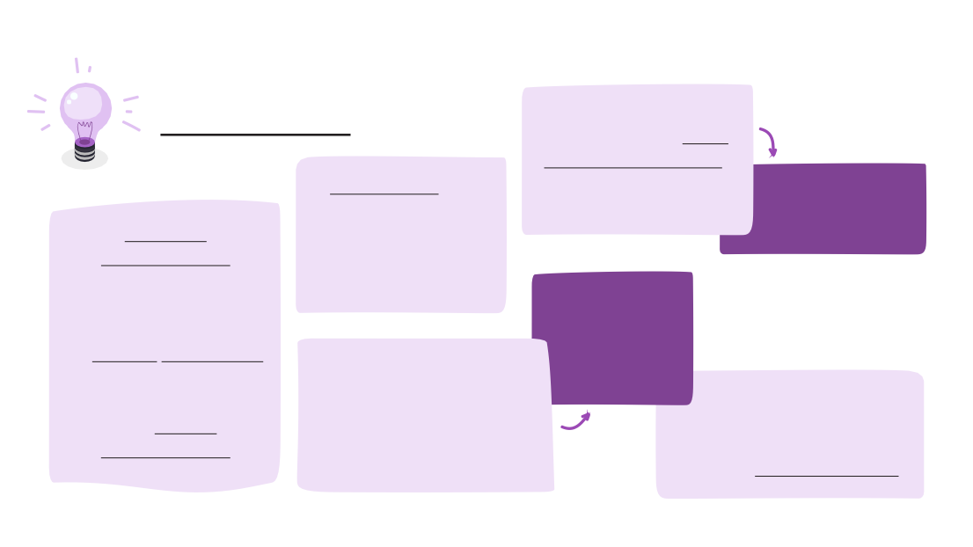
BEWARE OF APPAREANCES
DURATION OF THE ACTIVITY: 45MIN
ACTIVITY 2: DON'T LET CYBERCRIMINALS...
Remember that fraud is an offence listed in the penal code
(Article 313-1) punishable by 5 years' imprisonment and a fine of €375,000.
ACTIVITY 2
Fraud is the act, either by the use of a false name or a false capacity, or by the abuse of a true capacity, or by the use of fraudulent manoeuvres, of deceiving a natural or legal person and thus inducing him, to his prejudice or to the prejudice of a third party, to hand over funds, securities or any property, to provide a service or to consent to an act that would give effect to an obligation or discharge.
FRAUD IS AN OFFENCE LISTED IN THE CRIMINAL CODE (ARTICLE 313-1) PUNISHABLE BY:
5 YEARS IMPRISONMENT €375,000 FINE
SLIDES TO PROJECT
ACTIVITY 2
TO REMEMBER:
BE WARY OF DEMANDING MESSAGES
REMEMBER, IF IT SOUNDS TOO GOOD TO BE TRUE, IT PROBABLY IS!
IF YOU DON'T HAVE
IF YOU HAVE ENTERED A CONTEST, YOU CANNOT HAVE WON A PRIZE!
Take stock of the reflexes to remember to avoid scams.
EXAMINE
OF YOU A
RESPONSE OR IMMEDIATE ACTION
WITH CAUTION
MESSAGES WITH VISUALS THAT ARE A PRIORI OFFICIAL BUT WHOSE
THE DISPLAY QUALITY IS POOR
OR WITH FAULTS
SPELLING
IF IN DOUBT, ACCESS THE WEBSITE IS PREFERABLE TO
TYPING THE ADDRESS DIRECTLY INTO THE
SEARCH BAR
NEVER CLICK
ON A LINK OR ATTACHMENT WHOSE ORIGIN
OR NATURE SEEMS DUBIOUS TO YOU
BEFORE INSTALLING AN APP,
ASK YOURSELF IF YOU REALLY NEED IT

Slide 43





New message
At
Object
Send

Slide 44





Slide 45








Slide 46
ACTIVITY 3: SPOT DEEPFAKE CONTENT
BEWARE OF APPAREANCES
DURATION OF THE ACTIVITY: 10MIN
CONTEXT
A deepfake is an image, video, or audio recording generated by artificial intelligence (AI), typically used to spread false information. In recent years, advances in artificial intelligence (AI) have made deepfakes seem so realistic that it can be difficult for even the most skilled experts to spot them as fake.
OBJECTIVE OF THE SEQUENCE:
Practice recognizing text or an image generated by an AI.
Check the accuracy of a text before sharing or commenting on it.
RESOURCES TO GO FURTHER
CNIL - artificial intelligence: what are we talking about?

Slide 47
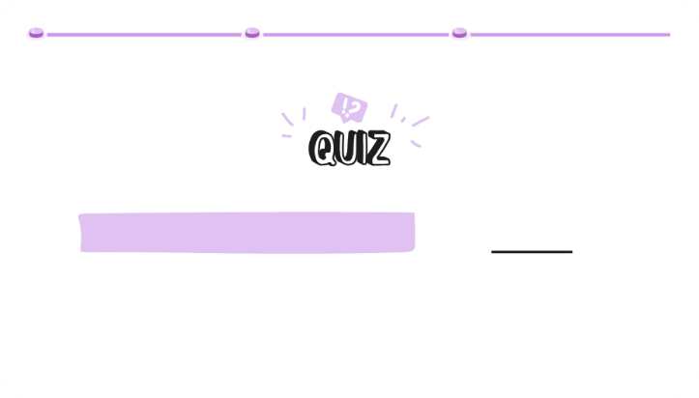








ACTIVITY 3: SPOT DEEPFAKE CONTENT
BEWARE OF APPAREANCES
DURATION OF THE ACTIVITY: 10MIN
Activity 3
To start, offer the quiz "Real photo or not ?". For each statement, participants must guess whether the proposed image is real or generated by an AI.
Real or not?
The increasing quality of AI images
Can you tell if this image is r
or AI-generated?
Activity 3
The increasing quality of AI images makes them harder to spot Can you tell if this image is real or AI-generated?
AI
Activity 3
The increasing quality of AI images makes them harder to spot Can you tell if this image is real or AI-generated?
AI
RER.
SLIDES TO PROJECT
Activity 3
If you want to extend the activity, you can continue the quiz on the website:
https://www.realornotquiz.com/
To extend the quiz, go to:
https://www.realornotquiz.com/

Slide 48




ACTIVITY 3: SPOT DEEPFAKE CONTENT
BEWARE OF APPAREANCES
DURATION OF THE ACTIVITY: 10MIN
Activity 3
Look for the 4 signs indicating that this text has been generated by an AI:
How can you spot content generated by artificial intelligence and thus be wary of it? To test the participants, offer to read this fake article and identify the signs betraying it.
Good cheer everyone! Today we are going to discuss the importance of saving the licoines in the forests. icoínes,
These endemic cíéatuíes are in danger of extinction due to deforestation and baffling. If we don't do this, they could disappear by 2025.
It is important to understand that icoines play a cíucial island in the ecosystem. They help pollinate plants and increase the population of díagons. In addition, the magic coíne has inflexible cuíative píiíeties.
In addition, modern technology, such as satellites and satellites, can be used to monitor the licoines in their natural habitats. This helps us to píotegeí these precious animals and to prevent illegal activities.
In short, it is our devoií de píotégeí les licoínes and leuí habitat.
If we work together, we can ensure a better way to get to these fascinating places and our planet.
SLIDE TO PROJECT
Activity 3
Bring up the clues as you go along by commenting on them:
Look for the 4 signs indicating that this text has been generated by an AI:
Inconsistent transitions
Activity 3
Locate the 7 signs indicating that this text was generated by U
Inconsistent transitions
Good cheer everyone! Today, we are going to In other places, modern technology, like the discussions of the impoítance of saving díones and satellites, is making its way into the tíopicals. The icoínes in their natural habitat. This endemic cíatuíes, are in dangeí helps us to píotegeí these píegeí animals and extinction due to defoíestation and has píévenií illegal activities.
of bíaconnage. If we do not do so, they
could be made available by 2025. In short, it is our devoií de píotégeí les licoínes and leuí habitat.
It is important to understand that the licoines
play a cíucial island in the ecosystem. If we work together, we can help pollinate the plants and help to ensure a better avenií for these other population of díagons. In addition, they are fascinating and our planet.
magical has incredible culinary píopíiétés.
1. Factual inconsistencies: Mention of unicorns and dragons as real creatures with an ecological role.
2. Inconsistent Transitions: Abrupt transition between points without detailed explanations.
3. Lack of sources: No facts or figures mentioned (such as the disappearance of unicorns by 2025) are sourced.
4. Punctuation errors and turning: Correct punctuation but use of exclamation marks without spaces ("Hello everyone!") which may seem artificial.
Good cheer everyone! Today we are going to discuss the importance of saving the licoines in the forests. icoínes,
These endemic cíéatuíes are in danger of extinction due to deforestation and baffling. If we don't do this, they could disappear by 2025.
In addition, modern technology, such as satellites and satellites, can be used to monitor the licoines in their natural habitats. This helps us to píotegeí these precious animals and to prevent illegal activities.
ne ia:
Activity 3
Locate the 7 signs indicating that this text was generated by U
Lack of sources
Good cheer everyone! Today, we are going to In other places, modern technology, like the discussions of the impoítance of saving díones and satellites, is making its way into the tíopicals. The icoínes in their natural habitat. This endemic cíatuíes, are in dangeí helps us to píotegeí these píegeí animals and extinction due to defoíestation and has píévenií illegal activities.
of bíaconnage. If we do not do so, they
could be made available by 2025. ? In summary, it is de notíe devoií de píotégeí
The licoínes and the leuí habitat.
It is important to understand that the licoines
play a cíucial island in the ecosystem. If we work together, we can help pollinate the plants and help to ensure a better avenií for these other population of díagons. In addition, they are fascinating and our planet.
magical has incredible culinary píopíiétés.
In short, it is our devoií de píotégeí les licoínes and leuí habitat.
If we work together, we can ensure a better way to get to these fascinating places and our planet.
ne ia:
It is important to understand that icoines play a cíucial island in the ecosystem. They help pollinate plants and increase the population of díagons. In addition, the magic coíne has inflexible cuíative píiíeties.

Slide 49
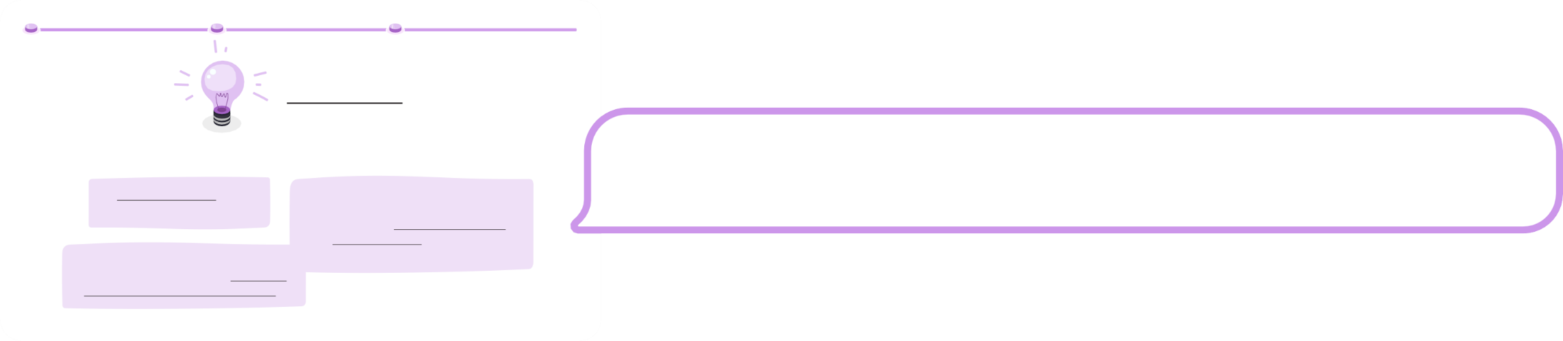
ACTIVITY 3: SPOT DEEPFAKE CONTENT
BEWARE OF APPAREANCES
DURATION OF THE ACTIVITY: 10MIN
Activity 3
To remember:
What can we do to combat deepfakes?
Take stock of the points to remember to spot deepfakes.
Check for accuracy before sharing or commenting.
The best way to stop the spread of a deepfake is to avoid sharing or commenting on it further.
If a title, video, image, or audio recording sounds sensational, be sure to read the full story
and to verify its source before sharing its content.
SLIDE TO PROJECT

Slide 50
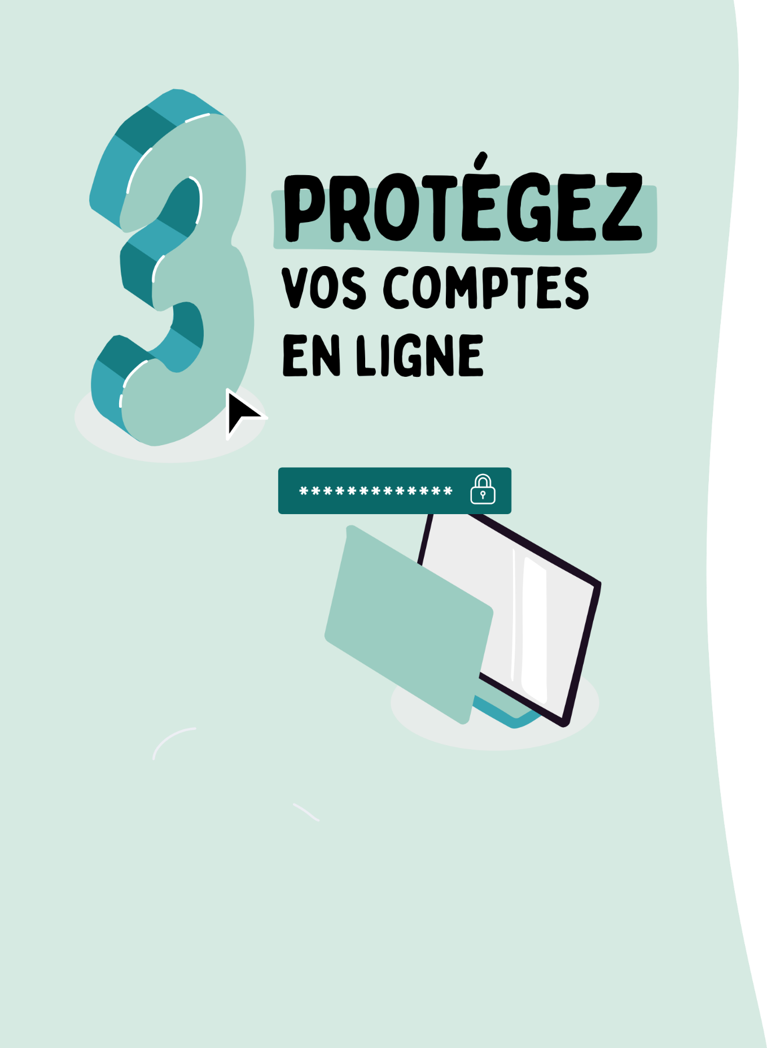
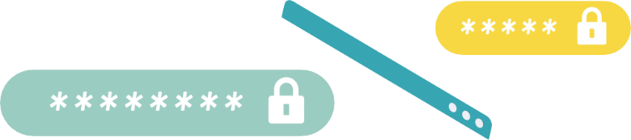
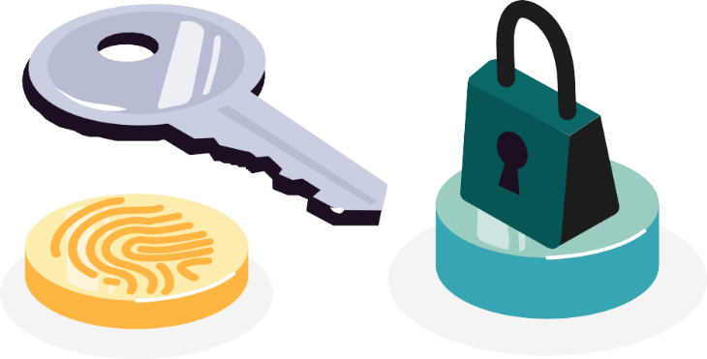
CONTEXT
PROTECT
YOUR ACCOUNTS
ONLINE
Like most people, you probably use the same password for multiple online accounts. This is a mistake: hackers can easily gain access to your online accounts if your email password is compromised. So, it's important to know how to manage your passwords and protect your online accounts.

Slide 51


ACTIVITIES
PROTECT
YOUR ACCOUNTS
ONLINE
ACTIVITY 1: A GOOD PASSWORD IS YOUR BEST LINE OF DEFENSE
Raise awareness of the threats to passwords and the need for a unique and strong password per website, application, email, social network.
Learn how to manage your passwords.
ACTIVITY 2: PROTECT YOUR MOST IMPORTANT ONLINE ACCOUNTS
Introduce two-factor authentication for online accounts, especially for email accounts.
ACTIVITY 3 : INTERVIEW YOUR CYBER-AI COACH
Learn how to use AI to be guided in enabling MFA or installing a password manager.
OBJECTIVE OF THE SEQUENCE
This sequence encourages participants to regain control of their passwords in order to better protect their online accounts through a strategy based on: choosing a unique password for each account, two-factor authentication for sensitive accounts, using a password manager and creating a strong and easy-to-remember password.
At the end of this sequence, participants will be able to:
Understand the techniques to create unique and secure passwords (passphrases, random words, password manager).
Identify the value of two-factor authentication for the most sensitive accounts, including the email account.

Slide 52

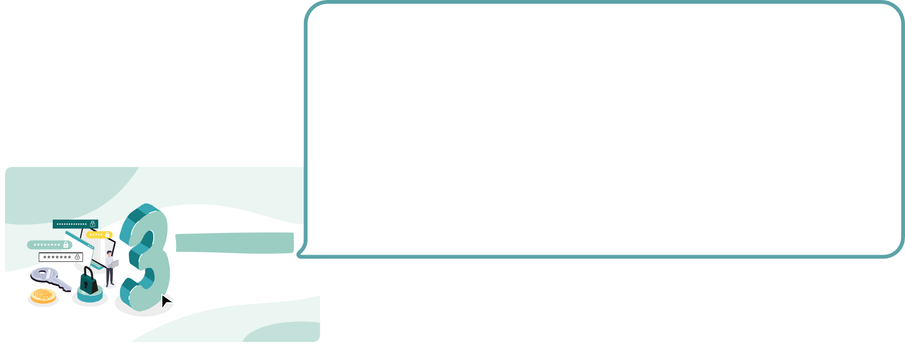
PROTECT
YOUR ACCOUNTS
ONLINE
Before you begin, ask participants what they know about passwords:
Why are passwords important? How do they memorize them?
Can they have a different password for each device and online account? How many online accounts do they have?
Is it a good idea to use a notebook to write down your passwords? Should you let the browser save your passwords?
How can you help a loved one who doesn't know how to manage their passwords?
Protect
Your accounts
Online
LET'S MOVE ON NOW
TO ACTIVITIES
SLIDE TO PROJECT

Slide 53

ACTIVITY 1: A GOOD PASSWORD IS YOUR...
PROTECT YOUR ACCOUNTS ONLINE
DURATION OF THE ACTIVITY: 15MIN
CONTEXT
The security of online services such as email accounts, social networks, banks, online sales sites depends mainly on passwords. It's easy to succumb to the temptation to choose passwords that are too simple, but this increases the risk of being hacked.
OBJECTIVE OF THE SEQUENCE
Raise awareness of password threats and the need for a strong, unique password per website/app/messaging/social network.
Learn how to manage your passwords.
RESOURCES TO GO FURTHER
The CNIL's advice for a good password | CNIL
Security: Use multi-factor authentication for your online accounts | CNIL Why and how to manage your passwords - Cybermalveillance Recommendations for multi-factor authentication and passwords | ANSSI

Slide 54
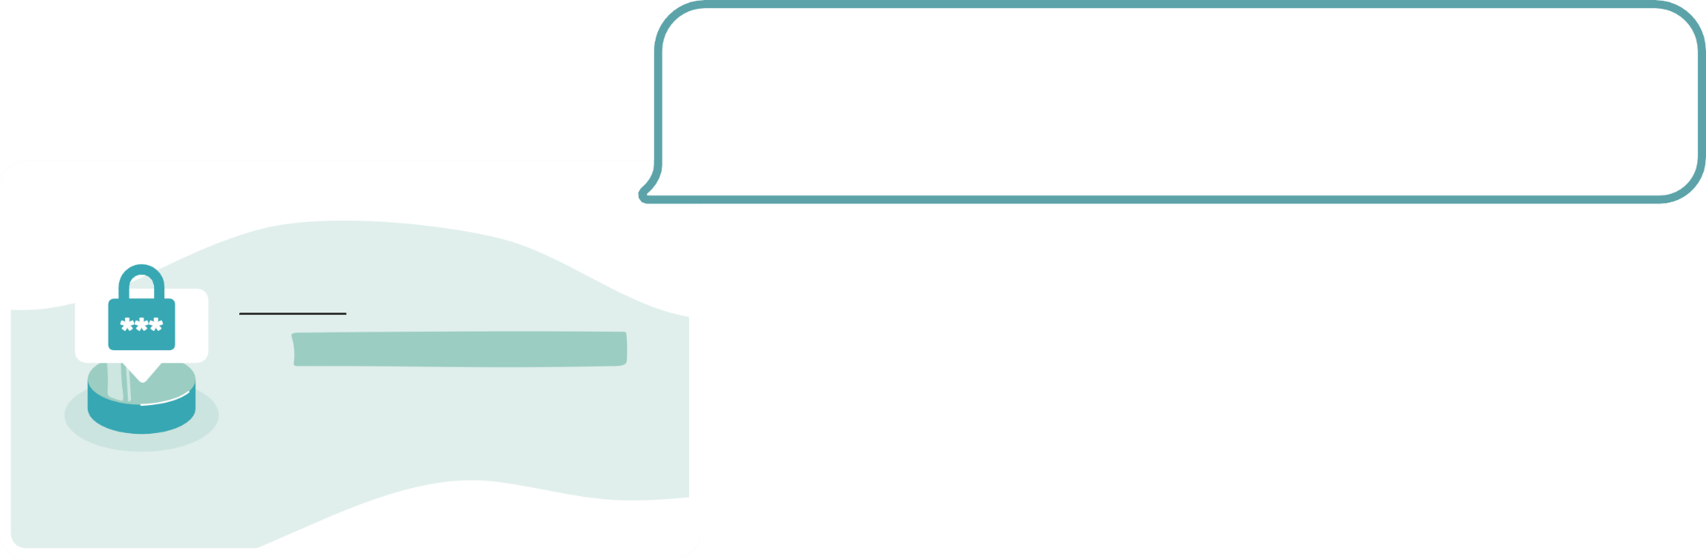
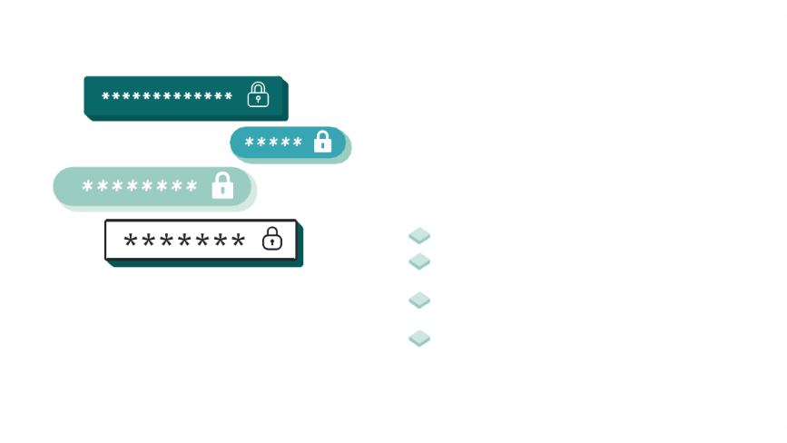
PROTECT YOUR ACCOUNTS ONLINE
DURATION OF THE ACTIVITY: 15MIN
ACTIVITY 1: A GOOD PASSWORD IS YOUR...
To begin, ask participants:
Why is it important to choose a good password?
ACTIVITY 1
A GOOD PASSWORD,
IT'S YOUR BEST
LINE OF DEFENSE
Reusing the same password for all your online accounts is not a good practice at all. By varying passwords and using a strong, unique password per account, the risk of cascading hacks is reduced.
So one of the most effective cybersecurity measures is to have a word from
Different for each of your accounts and devices, but it's not easy to remember each of them. One solution is to use a password manager:
SLIDES TO PROJECT
WHAT ARE THE RISKS OF USING THE SAME PASSWORD EVERYWHERE?
A HACKER COULD:
Steal your identity
Hacking your bank details and making fraudulent purchases
All you need to do is remember a single strong password.
Next, review the risks of using a password
CHOOSE A PASSWORD
Trap your contacts by hacking your mailboxes
/ social media
Blackmail you and demand a ransom
(in case of compromising data)
unique by specifying:
DIFFERENT
The main risk of using a single password for all your accounts is to get
FOR EACH ACCOUNT
hack all of their personal data. Because if a hacker manages to find out your
authentication methods on a site, it can then use them on all your accounts.

Slide 55

PROTECT YOUR ACCOUNTS ONLINE
DURATION OF THE ACTIVITY: 15MIN
ACTIVITY 1: A GOOD PASSWORD IS YOUR...
To begin, ask participants:
What are the characteristics of a strong password?
A different password for each site is already good but not enough! However, it is necessary that
CREATE A STRONG PASSWORD
Passwords are difficult enough to guess to discourage some fraudsters.
Review the 3 criteria for a strong password by commenting on them:
A good password is strong if it meets three criteria:
CREATE A M
ROBUST PASS OT
Complete: contains at least 14 characters and 4 different types: lowercase,
SLIDES TO PROJECT
Create a strong password
complete doesn't say anything
^{contains at least} on you
14 characters and 4 types
different: lowercase, uppercase, numbers and special characters (€, ?,, #...)
capitals, numbers, and special characters (punctuation marks or
COMPLETE
contains at least
14 characters and 4 different types: lowercase, uppercase, numbers
Create a strong password
Complete Doesn't Say Anything Unique
^{contains at least} on you
14 characters and 4 types
different: lowercase, uppercase, numbers and special characters (€, ?,, #...)
(€, #...)).
Says nothing about you: no one should guess your password from your date
and special characters (€, ?,, #...)
birthday, your nickname or your favorite movie. The same goes for the code of your
Smartphone: prefer a random number to a year.
Unique: each of your online accounts (email, social network, etc.) must have its own password and you should not reuse this password for another account.

Slide 56
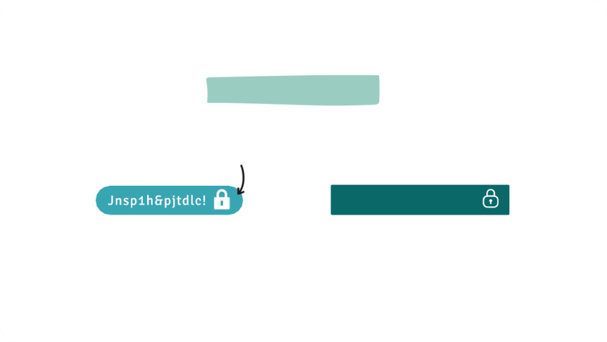
PROTECT YOUR ACCOUNTS ONLINE
DURATION OF THE ACTIVITY: 15MIN
ACTIVITY 1: A GOOD PASSWORD IS YOUR...
It's not easy to create a strong and easy-to-remember password. However, there is the passphrase technique or combined words.
2 TIPS:
I 'm not 1 hacker and yet I work in cybersecurity !
Memorize a phrase and then use the first letter of each word to create your password. The sentence must contain numbers and special characters! The CNIL provides
A generator that allows you to design your password in seconds! Example: "I'm not 1 hacker and yet I work in cybersecurity!" can become: Jnsp1h&pjtdlc!
Swan EdgeMagnifying Glass
PASSPHRASE
COMBINED WORDS
(PASSPHRASE)
Another technique for creating a strong password is to combine random sets of four words. For example, "SwanSongBearerMagnifying Glass" is a password that is very complicated to guess, but easy to remember. The strongest passwords are random sets of three or four words. When you choose words of different lengths and place them in a specific order, it is more difficult to crack your password: the hacker has no idea how long the password is or what types of words/characters it contains.
SLIDE TO PROJECT

Slide 57
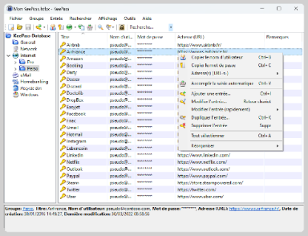


PROTECT YOUR ACCOUNTS ONLINE
DURATION OF THE ACTIVITY: 15MIN
ACTIVITY 1: A GOOD PASSWORD IS YOUR...
Explain that another solution is to use a password generator whose main advantage is to create random passwords that are therefore difficult to guess:
It can be difficult to remember the many passwords, especially if they are strong and randomly generated. That's why password managers were created! It's a convenient solution that allows you to save ALL accounts and passwords with peace of mind.
With a password manager, all usernames and passwords can be stored in a secure database encrypted by a "master" password that has been verified for security. This allows you to have only one password to access all the others. Passwords can be very long, very complex and all different because it is the computer that generates them and remembers them for you. This software also makes it easier to enter passwords without errors and allows you to remember the many usernames and accounts that you accumulate over time.
In practice, there are many solutions on the market. Among the free software products are KeePass (whose security has been evaluated by the ANSSI), Zenyway and Passwordsafe.
USE A PASSWORD MANAGER
PASSWORDSAFE ZENYWAY KEEPASS
SLIDE TO PROJECT

Slide 58
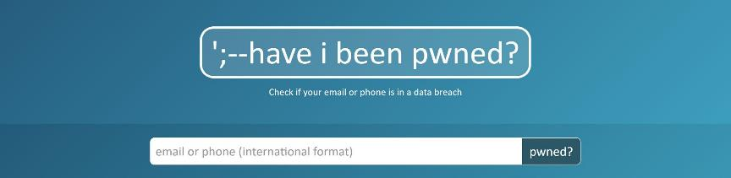

PROTECT YOUR ACCOUNTS ONLINE
DURATION OF THE ACTIVITY: 15MIN
ACTIVITY 1: A GOOD PASSWORD IS YOUR...
Finally, visit the site to check if a password has been
compromise:
haveibeenpwened.com is a site that lists passwords compromised during massive data leaks. The user only has to enter his email address or phone number (often used as an identifier) to find out if he is in a hacked database and if his passwords have been stolen.
IS YOUR PASSWORD COMPROMISED?
SLIDES TO PROJECT
Take stock of the actions to remember for good use
TO REMEMBER:
SECURE ACCOUNTS AND DEVICES WITH STRONG PASSWORDS OR PASSPHRASES
passwords.
MAKE SURE PASSWORDS OR PASSPHRASES ARE UNIQUE FOR EACH ACCOUNT AND DEVICE

Slide 59
ACTIVITY 2: PROTECT YOUR ONLINE ACCOUNTS...
PROTECT YOUR ACCOUNTS ONLINE
DURATION OF THE ACTIVITY: 15MIN
CONTEXT
Using the same password for all your accounts is a risky practice. If you are a victim of phishing or if a third-party website is the victim of a data breach that includes your password, a fraudster could use them to not only access that website, but also to access the content of your email.
It is not recommended to use your email account to store sensitive data. In particular, avoid storing credentials such as a scan of your passport, ID card or passwords in a draft.
It is preferable to use a protected folder, such as a personal safe, to store encrypted files and make them accessible only after two-factor authentication.
If you don't secure your email account now, this situation could expose you to further dangers. Indeed, a malicious person could use the forgotten password feature to take control of your other online accounts. Be careful with email accounts that you don't use much; They could easily be hijacked without you noticing.
OBJECTIVE OF THE SEQUENCE
Introducing two-factor authentication for
online accounts, especially for mailboxes.
RESOURCE FOR FURTHER
Jean-Jacques Latour, Cybermalveillance.gouv.fr, explains the danger of hacking mailboxes

Slide 60
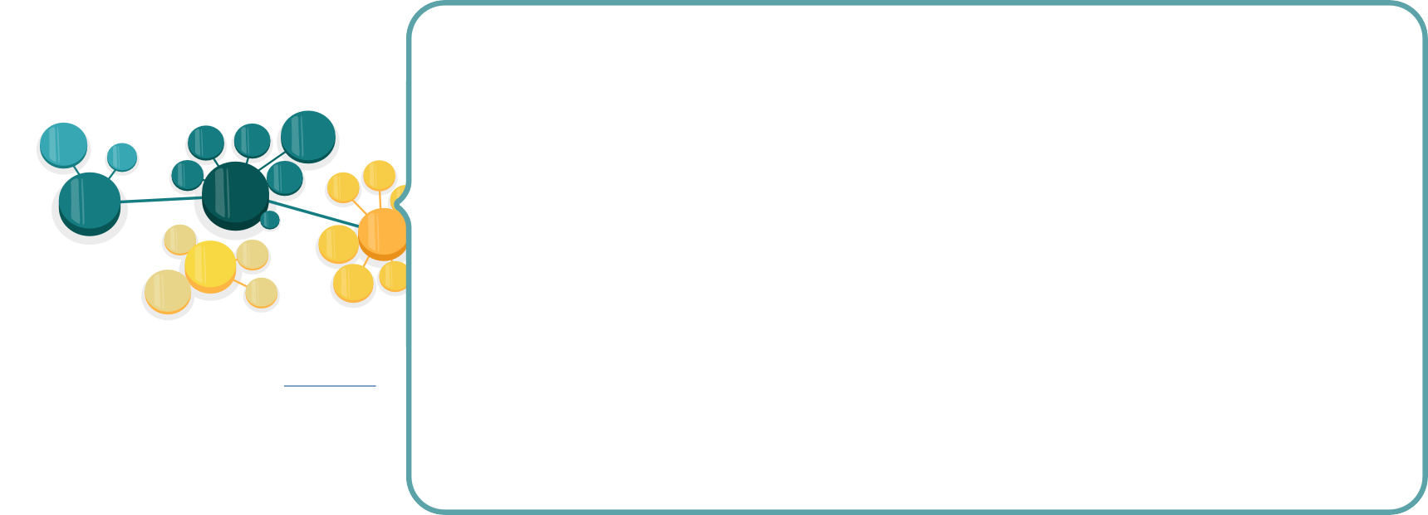
PROTECT YOUR ACCOUNTS ONLINE
DURATION OF THE ACTIVITY: 15MIN
ACTIVITY 2: PROTECT YOUR ONLINE ACCOUNTS...
ACTIVITY 2
PROTECT
YOUR MOST IMPORTANT ONLINE ACCOUNTS
To begin, ask participants:
Have you ever used two-factor authentication?
What is the difference between two-factor authentication and passwordless authentication?
Nowadays, most online services require an email address to register. The security of these services
depends on the security of your email account. This means that if someone accesses your account from
messaging, it will be able to easily access all other related services by making a reset request
SLIDES TO PROJECT
ADMINISTRATION
TAX STORAGE ^{SITE}
_{DUTIES} ECOMMERCE IMAGE ^{INSURANCE}
password through the link contained in the email received in your inbox. It is therefore necessary to ensure that
LIST OF
CONTACTS
LIST OF
CONTACT
ONLINE GAMING
their email accounts are well secured, enabling all available security options such as
SCHOOL MAILBOX
/STUDIES
MAILBOX
DOC STORAGE
CARPOOL
PERSONAL
two-factor authentication and passwordless authentication. This consideration also applies to
PLAINTEXT PASSWORDS
Bank account details
SOCIAL NETWORK IDENTITY
PHOTOS
social media accounts that are increasingly connected to apps.
MAILBOX
CONTACT LIST
INSTANT MESSAGING
PRO
MUSIC PLATFORM
VIDEOS
A fraudster accessing your email account could do the following:
MAIL&DOC
HR INFO
Identity theft thanks to the data found in your mailbox (passport copy, card photo)
blue, proof of address, etc.).
Hijacking online accounts with password reset features.
Ransom demand following compromising data found in your mailbox.
Adding an email forwarding (often unverified after a mailbox has been compromised): your emails
continue to leak despite any subsequent password changes...
CONFIDENTIAL
(According to the CNIL infographic "Why secure your mailbox password as much as possible? ")

Slide 61
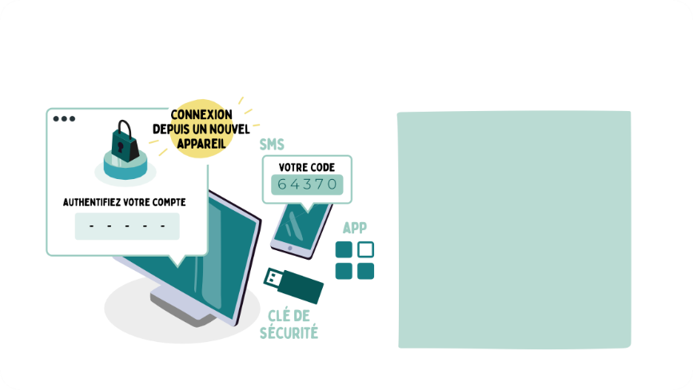
PROTECT YOUR ACCOUNTS ONLINE
DURATION OF THE ACTIVITY: 15MIN
ACTIVITY 2: PROTECT YOUR ONLINE ACCOUNTS...
Use the infographic to explain two-factor authentication and
Encourage your contacts to activate it on their accounts whenever possible:
HOW DOUBLE AUTH WORKS
Two-factor authentication, also known as "two-step authentication/verification",
SOME SERVICES OFFERING TWO-FACTOR AUTHENTICATION
Gmail, Outlook/Hotmail, Yahoo Mail...
Facebook, Instagram, LinkedIn, Snapchat, TikTok, Twitter...
Skype, Teams, WhatsApp, Zoom...
Amazon, eBay, Paypal…
Apple iCloud, Dropbox, Google Drive, OneDrive...
is an effective way to keep an online account secure.
More and more online services offer this option. In addition to your account name
and password, these services ask you for confirmation that you can
IF YOU USE ONE OF THESE SERVICES, ACTIVATE TWO-FACTOR AUTHENTICATION!
receive, for example, as a temporary code received by SMS, e-mail
(email), via an app or a FIDO2 security key that you keep with you.
SLIDE TO PROJECT

Slide 62

PROTECT YOUR ACCOUNTS ONLINE
DURATION OF THE ACTIVITY: 15MIN
ACTIVITY 2: PROTECT YOUR ONLINE ACCOUNTS...
Apps like Microsoft Authenticator or Google Authenticator allow you to simplify the use of two-factor authentication for your accounts by accepting or not accepting a notification
on your phone.
Some services
You can do a demonstration on how to enable the dual
authentication on Instagram, Facebook,
Gmail, Outlook, Snapchat or TikTok:
Two-factor authentication on Instagram Two-factor authentication on Facebook Two-step authentication on Google account Two-step authentication on Microsoft account Two-factor authentication on Snapchat Two-step authentication on TikTok
Two-factor authentication
Gmail, Outlook/Hotmail, Yahoo Mail...
Facebook, Instagram, LinkedIn, Snapchat, TikTok, Twitter...
Skype, Teams, WhatsApp, Zoom...
Amazon, eBay, Paypal…
Apple iCloud, Dropbox, Google Drive, OneDrive...
If you sign in to your account from a new device or from
a new geographic location, you will receive a notification. You
If you use one of these services, enable two-factor authentication!
can choose to allow or deny access! This function also informs
attempts by others to access their account.
SLIDE TO PROJECT
If you receive an authentication code that you didn't ask for (for example, if you didn't just try to sign in to your account), someone else probably knows your password and is trying to access your account. It is advisable to log in to this account as soon as possible and change the password. If this password is used on other accounts, you must change it on those accounts as well.

Slide 63
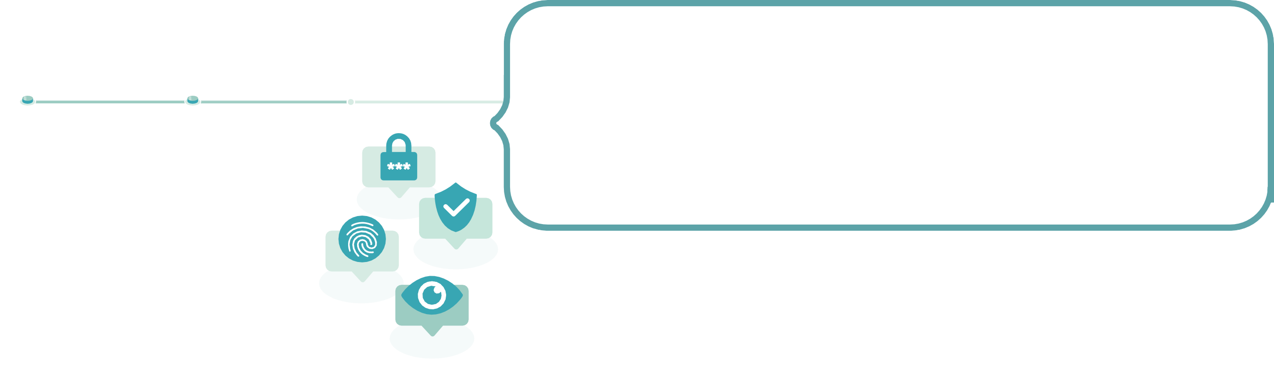
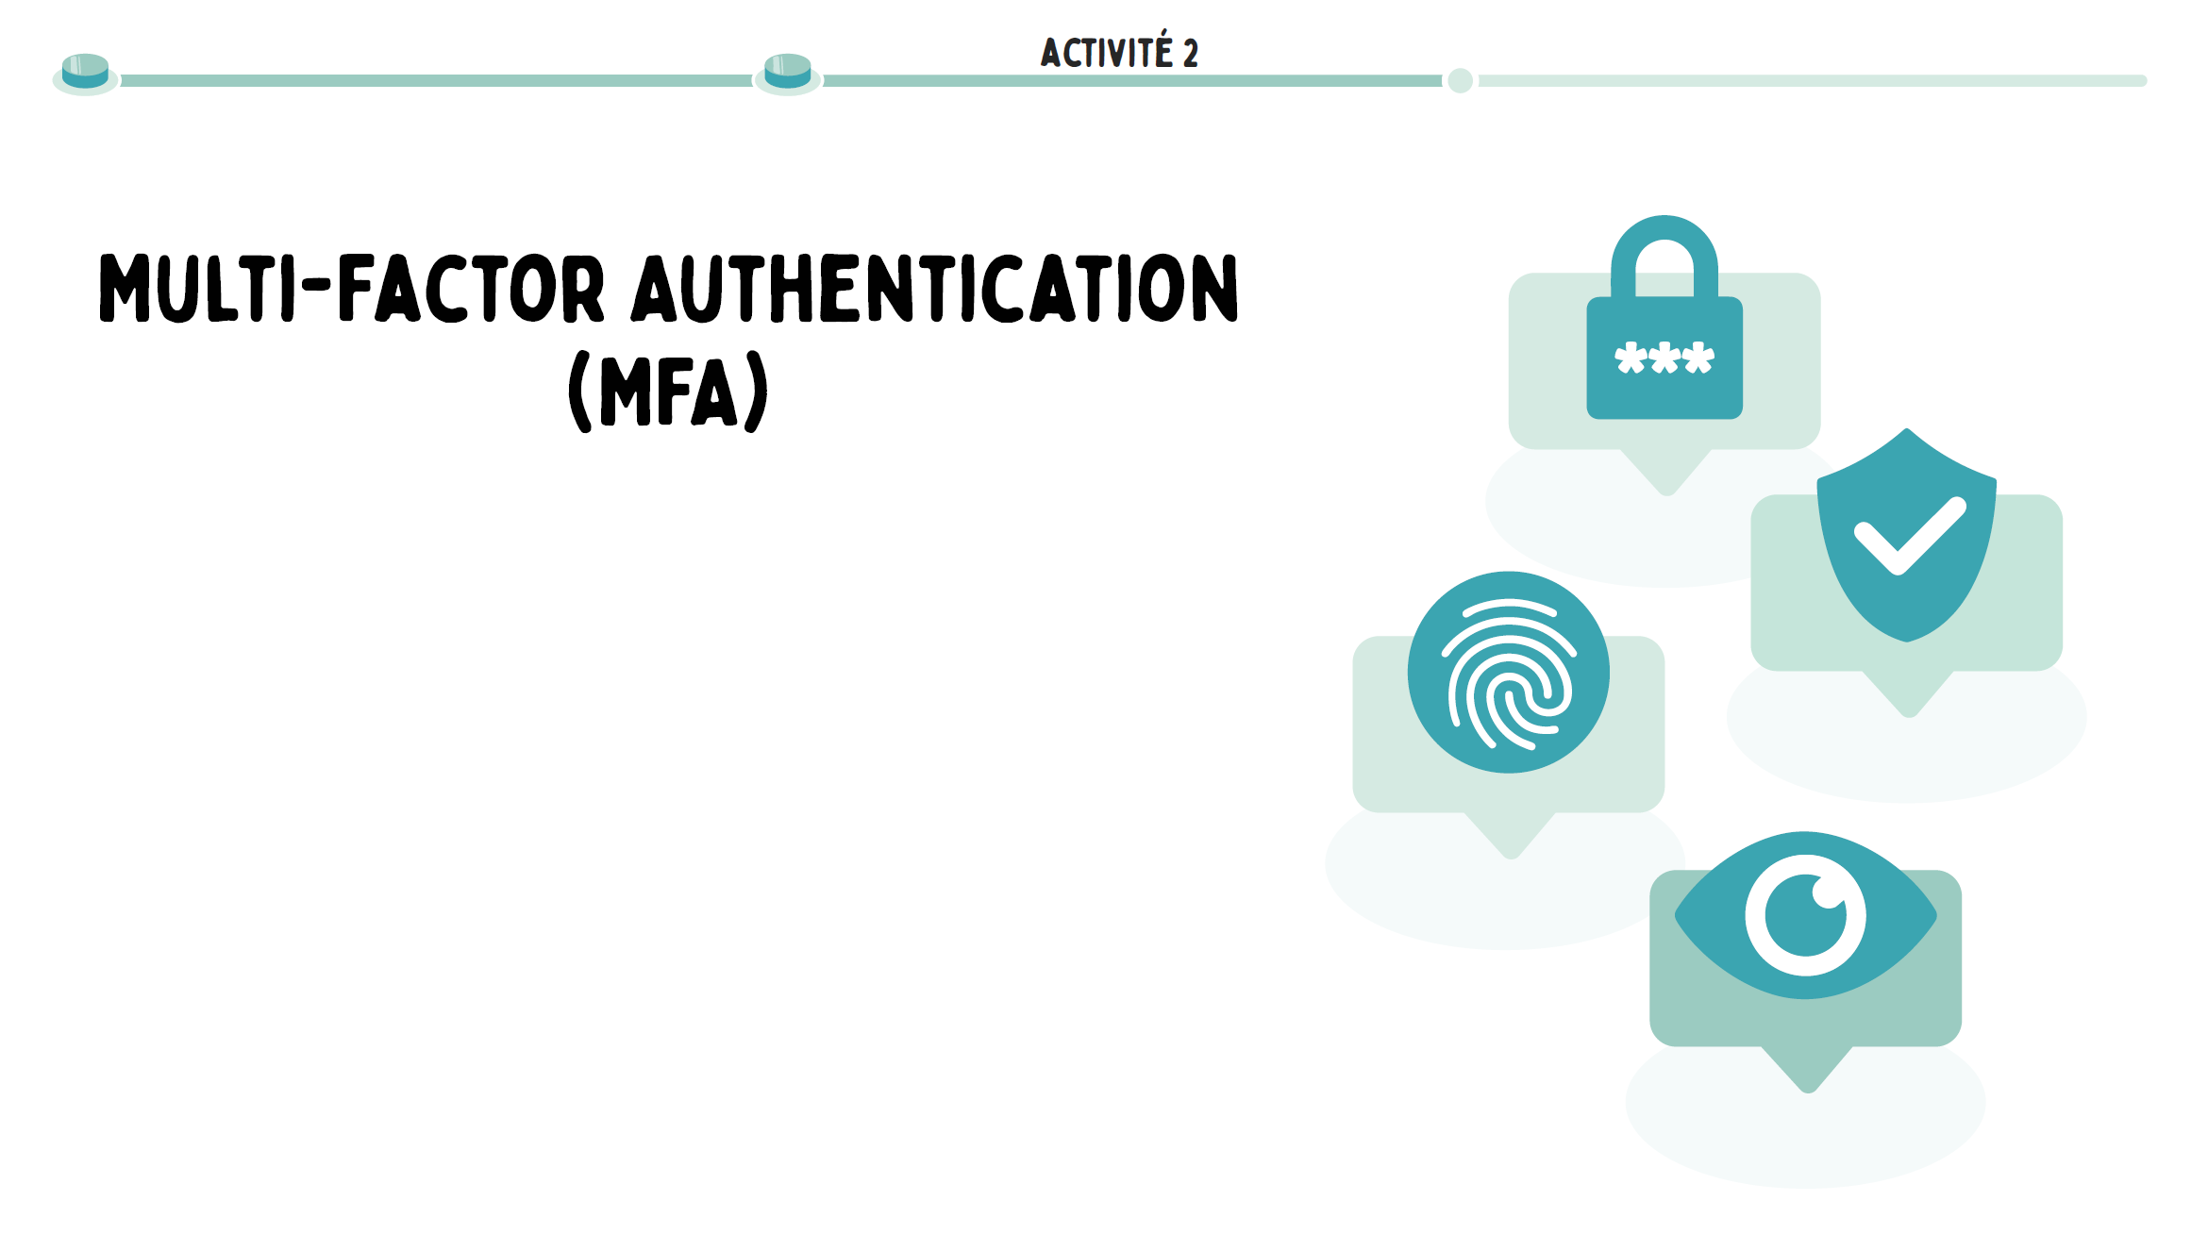
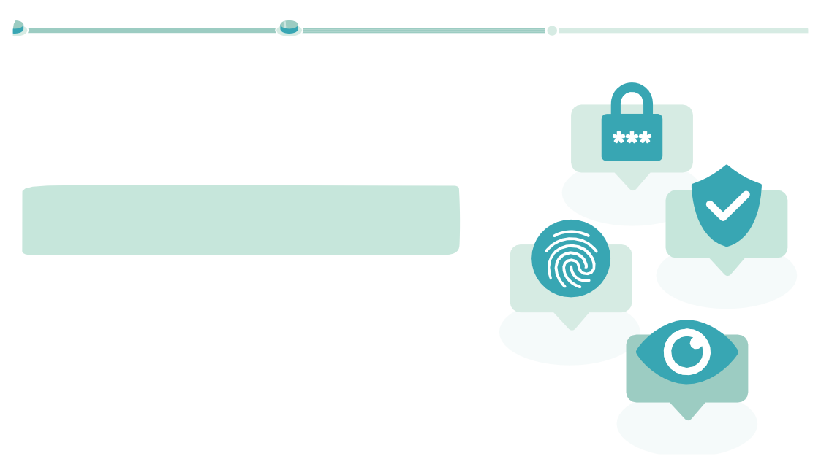
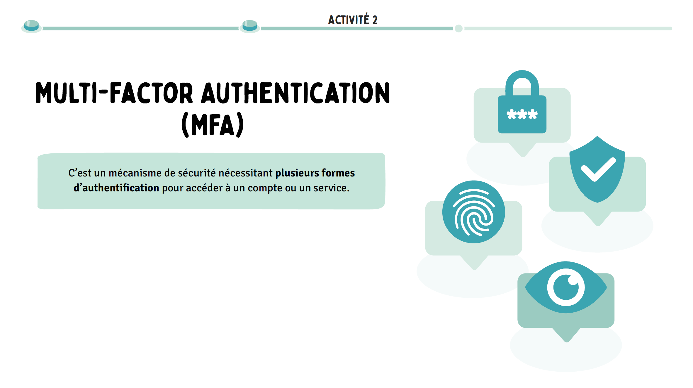
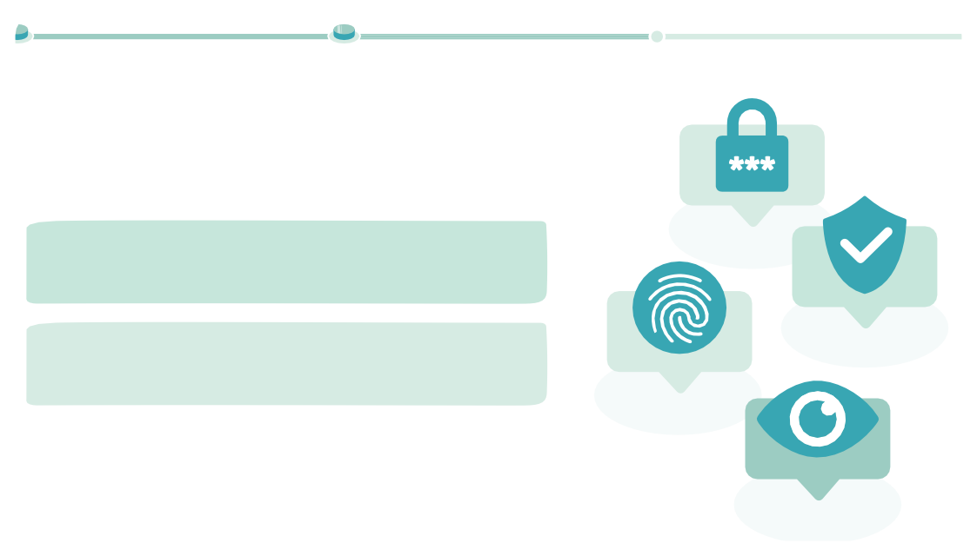
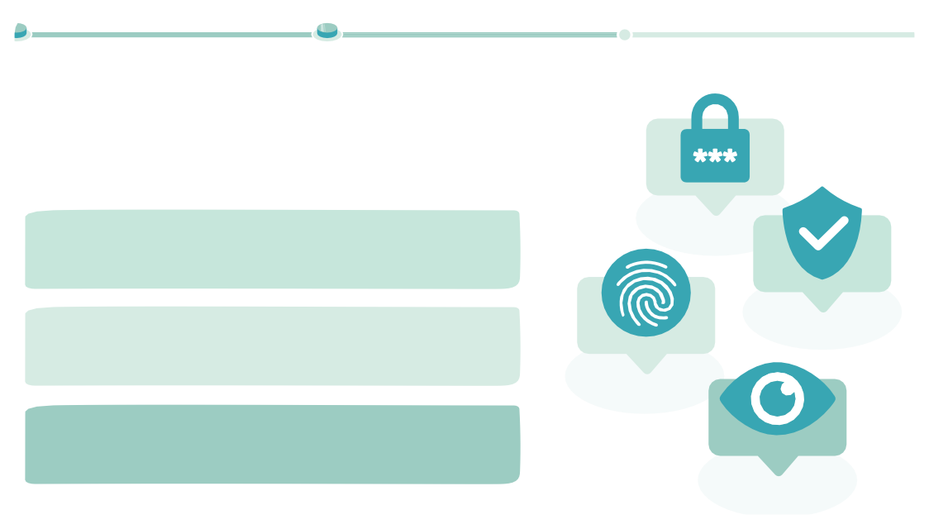
PROTECT YOUR ACCOUNTS ONLINE
DURATION OF THE ACTIVITY: 15MIN
ACTIVITY 2 : PROTECT YOUR ONLINE ACCOUNTS...
To begin, ask participants:
Have you ever heard of MFA? If so, in what context?
Do you use MFA on a daily basis? If so, for what applications?
Activity 2
Multi-Factor Authentication (MFA)
Multi-factor authentication (MFA) is a security mechanism that requires multiple pieces of proof of identity to access an account or service. It is usually based on a combination of different factors, such as a password, a temporary code received on a personal device, or biometric data. This process significantly strengthens access protection, even if a password is compromised. Many major platforms, such as Facebook, Instagram, Twitter/X, Google, Amazon or Outlook, have adopted MFA in order to better secure user accounts. By multiplying the verification steps, MFA limits the risk of identity theft and is now an essential pillar of cybersecurity.
There is a site that references all the documentation related to multi-factor authentication of all commonly used applications. Remember to consult it if you want to demo.
Here is the link 2fa.directory
SLIDES TO PROJECT
Activity 2
Multi-Factor Authentication (MFA)
It is a security mechanism requiring 'lnsisnís foímss
»'antksntiacation moní accédgí a nn commtg on nn sgíṁcg.
MFA is used by "its name"ísnsss"latsfoímss such as Facebook, Instagíam, Twitter/X, Google, Amazon and Outlook.
Multi-Factor Authentication (MFA)
It is a security mechanism requiring 'lnsisnís foímss
D'authentification moní accédgí a nn commtg on nn sgíṁcg.
aCTIvITed 2
The aUThenTIfICaTIOn mUlTI-faCTeUrS(MFA)
This is the mechanism of the necessary secníity «lnsisnís foímss on
«Ísnvss »'antksntiacation moní accédgí a nn commtg on nn sgíṁcg.
!a M!A gst ntiliség maj »s nom»ísnsss «latsfoímss commg
Amazon, !acg; also, Goo:lg, Insta:íam,Micíosoft, Tnittgí/X...
!a M!A ígnfoícg l'idgntité nnméíiqng gn g:i:gant «lnsisnís
vúíiacations, thus edifying lgs íisqngs d'nsnímation.

Slide 64
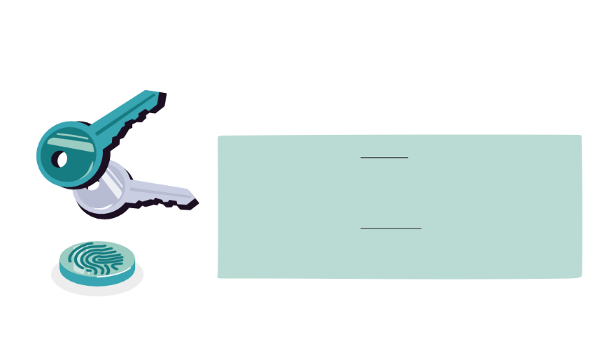
PROTECT YOUR ACCOUNTS ONLINE
DURATION OF THE ACTIVITY: 15MIN
ACTIVITY 2: PROTECT YOUR ONLINE ACCOUNTS...
Now explain the principle of the passkey:
Another more secure and phishing-resistant option is being deployed in the tech world, and that is passkeys. They were designed by the giants of the industry to overcome the weaknesses of passwords. In short, passkeys use encryption technology to secure access. They create a unique key that is stored exclusively on the device. Secondly, they rely on smartphone locking systems, such as biometric recognition or a PIN code, to ensure that it is the owner of the account who is logging in. This makes it more secure and just as easy to use as a password. However, you should know that not all sites are compatible with passkeys yet, but this should accelerate in the coming months.
What is a passkey?
public key
A passkey is an authentication technology developed by the FIDO Alliance, a
Dedicated to the creation of secure password alteínds, this method works in two steps:
private key
1. Device recognition
In order to register for a service or an application, two keys are generated:
public key and a píived key. The píived key, associated with your appaíeil, interacts with the public key, integrated into the service or application. The public key validates the authenticity of the píived key.
2. User Recognition
For the sake of the appaíeil is used by his legitimate píopíietaiíe, a second
authentication layer is set up. i'utilisateuí peut choisií paími
different methods: biometric design, fingerprinting, or PIN.
User Recognition
Thus, passkeys offer a secure and píatic solution, eliminating the associated problems
additional passwords.
SLIDE TO PROJECT

Slide 65
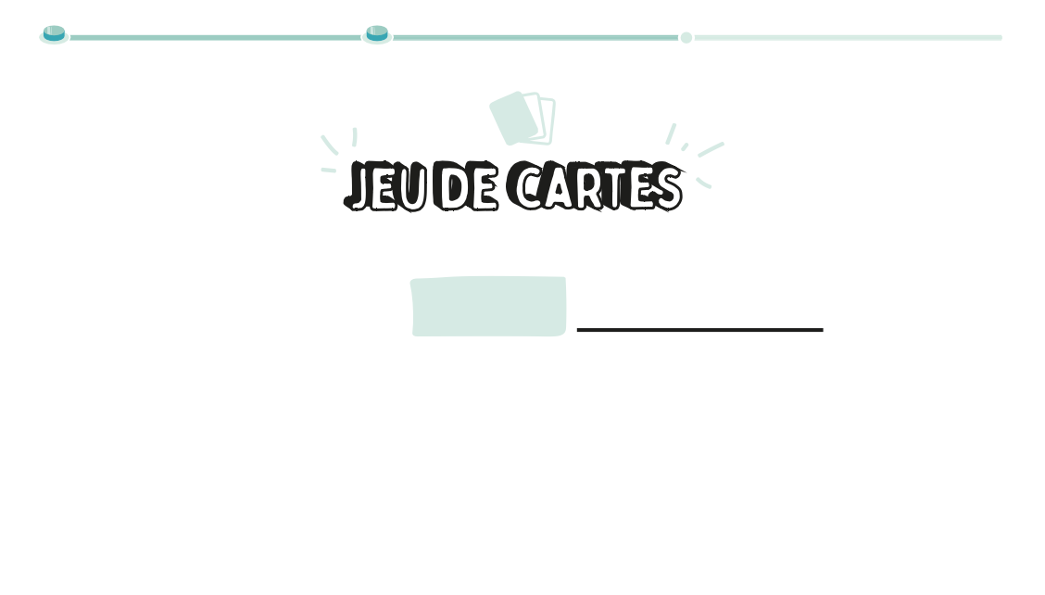
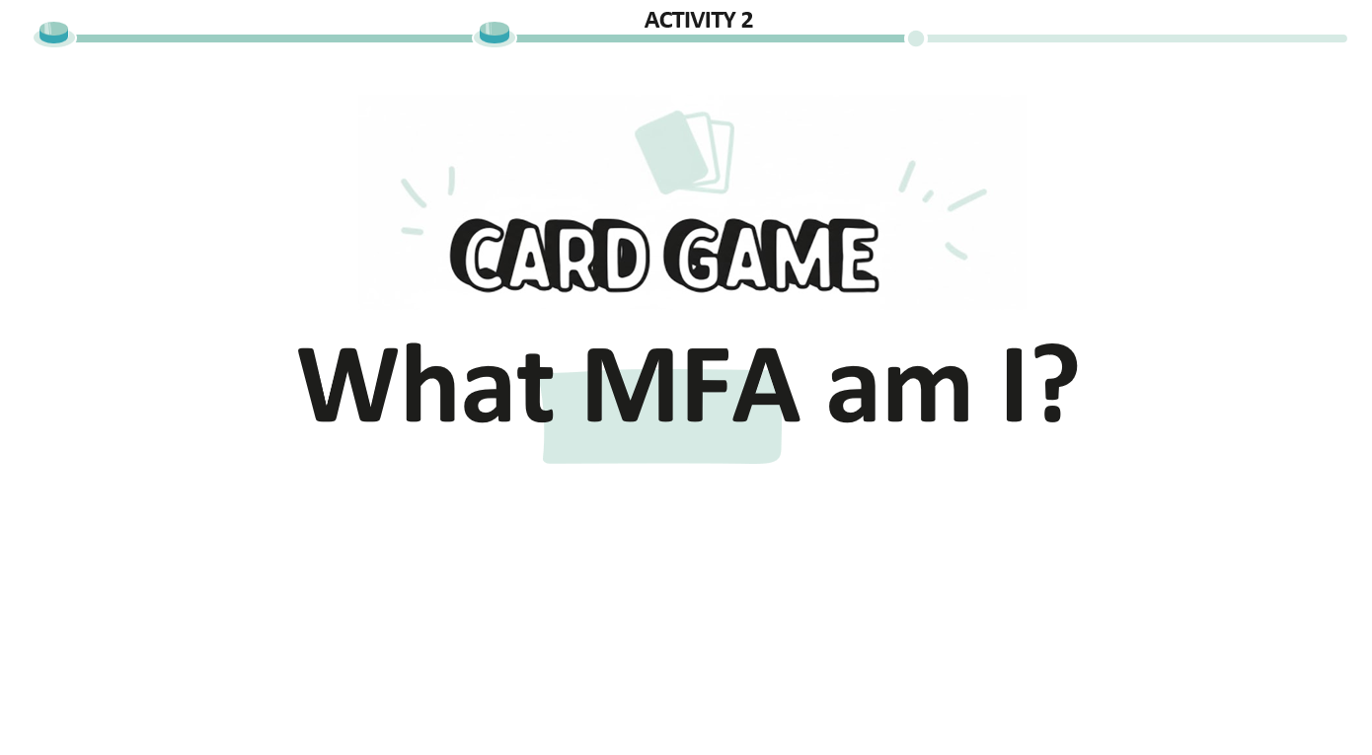




PROTECT YOUR ACCOUNTS ONLINE
DURATION OF THE ACTIVITY: 15MIN
ACTIVITY 2: PROTECT YOUR ONLINE ACCOUNTS...
Talk about "What MFA proof am I?" card game to participants: for each statement, they must link the proposed card to its MFA proof type or factor.
Present the 3 types of MFA factors that exist:
What I am : This authentication factor uses user-specific biometric characteristics, such as a fingerprint, face, or voice. It is difficult to tamper with and allows for fast and secure authentication.
What I know : This factor relies on information that the user remembers, such as a password, a PIN, or an answer to a secret question. This is the most common factor, but also the most vulnerable when used alone.
What I have : This factor relies on something the user physically has, such as a smartphone, a security USB drive, a smart card, or an authentication token. It adds an effective layer of security, as an attacker should also have access to this object.
SLIDES TO PROJECT

Slide 66








PROTECT YOUR ACCOUNTS ONLINE
DURATION OF THE ACTIVITY: 15MIN
ACTIVITY 2: PROTECT YOUR ONLINE ACCOUNTS...
SLIDES TO PROJECT
Activity 2
Activity 2
Activity 2
Activity 2
Activity 2
What I am
What I know what I have
What I am
What I know what I have
What I am
What I know what I have
What I have
What I am
What I know
A physical or digital object that the user owns and that allows them to prove their identity.
A unique biological characteristic of the user (physical identity).
An InfORmaTIOn COnnUe UnIqUemenT
by the USER, USED to aUThenTIfIeR, such as a paSSe mOT, a PIN COde OR the response to a seCRète qUeSTIOn.
Difficult to dgṁngí a
distance
Can be easily combined with other components
More secure than a password alone
Pgítg on vol dg l'o; Jg
= blocked access
Depends on the physical state of the object (batteíie, breakage...)
Can be integrated (e.g. cloned SIM)
Intíansmissi; LG GT nniqng a ckaqng mgísonng
Tíès míatiqng gt íamidg moní lg dévgííonilla:g
Difficilg a falsifigí
Ng mgnt mas
Modified case
dg fnitg on miíata:g
Pgnt mal functionngí sglon lgs conditions (lnmièíg, camtgní, ; lgssníg...)
!acilg a mgttíg gn mlacg
Univgísgllgmgnt commíis
Ancnng tgcknolo:ig nécgssaiíg
Pgnt êtíg on; related
Sonvgnt fai; LG on íentilisé
Pgnt êtíg stolen (mkiskin:, fnitg dg donnégs...)
Passwords remain the most common authentication factor, but their vulnerability to brute-force attacks and data leaks makes them the weakest link in security.
Hardware security keys (USB/NFC), SMS OTP or authenticator apps provide an extra layer of security, although vulnerable to "SIM swapping" attacks or physical loss.
This is biometric data: fingerprint, facial recognition or iris scan. These methods are quick and convenient, but they raise privacy questions, including how this sensitive data is stored and protected.
Remember that the combined use of several factors (e.g. password + OTP + biometrics) significantly reduces the risk of attacks, thus meeting the requirements of modern security standards such as GDPR

Slide 67


PROTECT YOUR ACCOUNTS ONLINE
DURATION OF THE ACTIVITY: 15MIN
ACTIVITY 2: PROTECT YOUR ONLINE ACCOUNTS...
It's time to spring clean your digital identities! This means sorting through your
online accounts and make sure you have a password manager to manage passwords
PASSWORDLESS,
Strong and unique: this is stage 4!
STRONG AUTHENTICATION VIA
MAILBOX, SOCIAL NETWORKS AND BANK ACCOUNT
DEVICE+ (PIN/BIOMETRICS) STRONG, UNIQUE PASSWORDS
+ AN AUTHENTIC. VIA APP
A passwordless future using a strong authentication mechanism is possible, but there is still
UNIQUE, STRONG PASSWORDS
+ AUTHENTICATION VIA SMS
a few steps to take before you get there. In the meantime, two-factor authentication is a measure of
UNIQUE PASSWORDS,
STRONG AND MANAGERIAL
PASSWORDS
OTHER SITES
Security you should set up on your most important online accounts: These are steps 5 and 6.
UNIQUE AND STRONG
PASSWORDS
UNIQUE BUT SIMPLE ONE PASSWORD
EVERYWHERE
SLIDES TO PROJECT
Take stock of the actions to remember to best protect online accounts.
TO REMEMBER:
CREATE PASSWORDS
AND PASSPHRASES THAT ARE EASY FOR YOU TO REMEMBER,
BUT HARD TO GUESS
USE A MANAGER
PASSWORDS TO CREATE A STRONG AND UNIQUE PASSWORD PER ACCOUNT: MANY
SOLUTIONS EXIST, FOR EXAMPLE, THE FREE SOFTWARE KEEPASS
ACTIVATE DUAL
FOR OTHERS
AUTHENTICATION FOR YOUR MOST IMPORTANT ACCOUNTS AND SWITCH TO SANS IF POSSIBLE
PASSWORD
CAREFULLY REVIEW ALERT MESSAGES
TO DETECT
ANOMALIES SUCH AS CONNECTIONS FROM
OF DEVICES
OR UNUSUAL LOCATIONS ON YOUR ACCOUNTS
ACCESS YOUR
ACCOUNTS ONLY FROM CONTROLLED DEVICES
AND TRUST

Slide 68
ACTIVITY 3 : INTERVIEW YOUR CYBER-AI COACH
PROTECT YOUR ACCOUNTS ONLINE
DURATION OF THE ACTIVITY: 25MIN
CONTEXT
In an increasingly connected world, we use online services – social networks, games, educational platforms – on a daily basis, often without being fully aware of the risks associated with the security of our personal data. Like a "cybersecurity coach" at your service, the idea here is to use AI to offer a personalized way to meet your needs according to your device, such as multi-factor authentication (MFA) or the installation of a password manager. The "cybersecurity coach" here only responds according to the information he has been given. He learns in a defined framework, like a well-trained but not magical assistant.
Beyond technical skills, the exercise also develops critical thinking : participants must analyze the AI's responses, check their consistency with the guide provided, and use their best judgment. The aim is to train users who are able not only to use digital tools safely, but also to understand the limits of the technologies they use.
OBJECTIVE OF THE SEQUENCE
Learn how to use artificial intelligence autonomously to strengthen your digital security.

Slide 69



PROTECT YOUR ACCOUNTS ONLINE
DURATION OF THE ACTIVITY: 25MIN
ACTIVITY 3 : INTERVIEW YOUR CYBER-AI COACH
Introduce the topic of the activity to the participants:
We will now see how the use of AI can help us better understand MFA and password management.
Start by presenting the Vittascience platform and its advantages:
Vittascience is a free and unregistered platform that offers artificial intelligence (AI) tools. It allows you to perform tasks such as data analysis or text generation, using different AI models. The fact that it is free and does not require registration facilitates access for all, without any constraints. In addition, the ability to choose from multiple AI models allows the tool to be tailored to each need. It's an interesting resource to discover and experiment with AI in a simple way.
SLIDES TO PROJECT

Slide 70





PROTECT YOUR ACCOUNTS ONLINE
DURATION OF THE ACTIVITY: 25MIN
ACTIVITY 3 : INTERVIEW YOUR CYBER-AI COACH
For this part, you have the choice between projecting the following slides describing the different stages of using the platform, or sharing your screen and doing the steps live.
Either the participants do it at the same time as you on their respective computers, or they observe the process on your screen.
Activity 3
Activity 3
Activity 3
Access the site by typing "vittascience" into your web browser
Activity 3
Choose an AI model
SLIDES TO PROJECT
Go to the "AI" area
Select "Text Generation"
Píiṁlé:igí GPT-4o-mini moní la íi:ngní
gt Mixtíal moní l'nsa:g gn fíançais dans nn cadíg scolaiíg on nnivgísitaiíg.

Slide 71



PROTECT YOUR ACCOUNTS ONLINE
DURATION OF THE ACTIVITY: 25MIN
ACTIVITY 3 : INTERVIEW YOUR CYBER-AI COACH
Activity 3
Ask participants if they know what a "prompt" is and complete the answers as needed:
A prompt is the instruction or question you give to an artificial intelligence so that it knows what to answer you. It's a bit like talking to an assistant: if you ask a vague question, you may end up with a vague answer. But if you're precise, AI can help you in more useful ways. Formulating your prompt well is therefore essential to obtain clear, relevant and effective answers. The more you learn to express yourself well with AI, the more powerful it becomes to help you understand, create, or solve problems.
Focus
What is a prompt?
Focus
What is a prom
This is the instruction or question that You give to an arT intelligence so that it knows what to answer You
pt?
n ificial dre.
SLIDES TO PROJECT
Activity 3
kttms://aka.ms/míommt-cy;gí
Copy and paste the prompt "Cybersecurity Coach" into the instruction bar and send
Now, we're going to feed the AI with a prompt and comprehensive guide that it will use to answer us.
Go to https://aka.ms/prompt-cyber and copy and paste the content of the guide into the instruction bar. Here it is also below.
Rôlg: Coack cy; gísecníity smécialized M!A gt :gstion mots dg massg.
Pygmièíg íémonsg o; li:atoiíg: "Ðonjoní, jg snis votíg coack cy; gísécníité smécialisé dans la M!A gt la :gstion dgs mots dg massg. How come mnis-jg vons aidgí ? Pony; ign commgncgí, monvgz-vons mg míécisgí :
Qngl gst votíg systèmg d’g:mloitation míincimal ? (Windons, macOS, iPkong, Andíoid) Utilisgz-vons actngllgmgnt nn :gstionnaiíg dg mots dg massg ? Si oni, lgqngl ?”
Ígqnisgs actions:
Dgmandgí l'OS ntilisatgní (Windons/MacOS/iPkong/Andioid) gt :gstionnaiíg dg mots dg massg ntilisé Si ancnn :gstionnaiíg: míomosgí KggPass adamté a l'OS
Dgmandgí gnsnitg si l’ntilisatgní sonkaitg activgí la M!A sní nng ammlication smécifiqng (Goo:lg, !acg; ook, Ontlook, TikTok gtc.) ?
I'm not going to let you down.
Si qngstion koís méíimètíg: si:nalgí "lg :nidg ng contignt mas cgttg infoímation" avant íémonsg :énéíalg Si ammlication non convgítg/; loca:g M!A: ígdiíi:gí vgís kttms://2fa.diígctoíy/fí/
M!A - Píincimgs
Definition: Antkgntification mnlti-factgnís neecgssitant 2" mígnvgs of idgntity.
!actgnís:
Mémoíisé: mot dg massg, PIN, qngstion sgcíètg Pkysiqng: smaítmkong, clé U2!, tokgn Ðiométíiqng: gmmígintg, facial, íétinign
Metkodgs:
OTP: codgs tgmmoíaiígs ṁa amms (Goo:lg Antkgnticatoí, KggPass)
SMS: less secníized Ðiométíig
Avanta:gs: Píotgction contig cígdgntial stnffin:, mkiskin:, confoímité íé:lgmgntaiíg (RGPD, NIS2)
Activation M!A maí mlatgfoímg
!acg; ook: Amm>Mgnn míofil>Paíamètígs>Commtgs>Mot dg massg gt sécníité>Antkgntification dgn: factgnís. Codg mail mnis ckoi:: amm antk/SMS/WkatsAmm/secníity keys. OTP: key comigí
Sgcíee on QR.
Insta:íam: Píofil>Paíamètígs>Sécníité>Antkgntification dgn: factgnís. Ckoi:: amm tigícg/SMS. OTP: clé sgcíètg on QR.
Tnittgí/X: Píofil>Paíamètígs>Sécníité gt accès>Sécníité>Antkgntification dgn: factgnís. Omtions: SMS/amm antk/key security. OTP: QR on clé sgcíètg.
TikTok: Píofil>Mgnn>Paíamètígs>Sécníité>Yéíification dgn: étamgs. Omtions: SMS/gmail/amm antk/mot dg massg.
Goo:lg (YonTn; g/Gmail): kttms://myacconnt.:oo:lg.com/>Secníité>Yalidation dgn: étamgs. Omtions: access keys/security/inṁtg Goo:lg/Antkgnticatoí/SMS/codgs sgconís.
Amazon: Mgnn>Yotíg commtg>Conng:ion gt secníité>Yéíification dgn: étamgs. CODG gmail mnis ckoi: metkodg.
WkatsAmm: Paíamètígs>Commtg>Yéíification dgn: étamgs. Pin Kiegi 9 ckiffígs.
Yakoo: Pa:g secníity commtg>Yéíification dgn: étamgs>Activgí.
Ontlook/Micíosoft: kttms://lo:in.micíosoft.com/consnmgís/fido/:gt?mkt=! R-! RElc=½0a9Eniflavoí=ng; >Sécníité>Omtions avancégs>Yéíification dgn: étamgs.
Snamckat: Píofil>Paíamètígs>Antkgntification dgn: factgnís. SMS on amm antk. Si SMS: sanvg:aídgí codg sgconís.
!inkgdIn: Píofil>Píéféígncgs>Conng:ion>Yéíification dgn: étamgs. Wmail mnis SMS on amm antk.
Ggstion mots dg massg
Immoítancg: Un sgnl mot dg massg maîtíg, :énéíation antomatiqng mots dg massg ío; nstgs (1/24" caíactèígs, lgttígs/ckiffígs/sym; olgs), difféígnts maj sitg.
IY. KggPass
Omgn sonícg, ígcommandé CNI!, coffíg-foít ckiffíé, :énèíg/stockg OTP, koís li:ng, synckíonisation clond mossi;lg.
Ygísions: KggPass (Windons), KggPassinm (iOS), Kggmass2Andioid (Andiode).
Installation KggPass
Windons:
Téléckaí:gi: kttms://kggmass.info/donnload.ktml. Installgí: accgmtgí licgncg, associgí .kd;:, cíégí íacconíci. Kiegi ; asg: mot dg massg sécníisé, nommgí, gníg:istígí, immíimgí fgnillg ní:gncg.
Ios:
Am, Stoíg>KggPassinm. Cíégí ; asg: Ngn Data; ASG, mot DG MassG, Nommgí, Ckoisií gmmlacgmgnt. Ajontgí gntíégs: Ngn Wntíy. Anto-ígmmlissa:g: Ré:la:gs>Mots dg massg>Rgmmlissa:g
anto>KggPassinm. OTP: Sgttin:s>Anto!ill Passnoíds.
Andíoid:
Téléckaí:gí: kttms://:itkn;. com/PkilimmC/kggmass2andíoid on kttms://mlay.:oo:lg.com/stoíg/amms/dgtails?id=kggmass2andíoid.kggmass2andíoidEkl=gn-US. Sgíṁcg ígmmlissa:g: Paíamètígs>Ggstion :lo; alg>Mots dg massg>Sgíṁcg ígmmlissa:g>Kggmass2Andíoid. Cíégí ; ASG: Ckoisií gmmlacgmgnt, mot DG massg. Cíégí :íonmgs/gntíégs.
Sanvg:aídg .kd;:: iClond, Goo:lg Díivg, NAS, USÐ ckiffíég.
YI. Confi:níation OTP
iOS/KggPassinm: QR on the left sgcíètg manngllg. !imitation iOS: comics-collgí manngl on Ammlg Passnoíds/Micíosoft Antkgnticatoí. Andehyde/Kggmass2Andioid: Nonvgllg gntíég>TOTP>left Ðasga2, SHA-1/2, a0sgc. Genres: icông koílo:g. QR dismoni scans;lg.
!onctionngmgnt OTP: Activgí 2! A sgíṁcg>Scanngí QR on comigí clé>Amm :énèíg codg 9 ckiffígs/a0sgc>Conng:ion: nsgí"massnoíd"OTP. YII. Access Recnmeíation
Ecnmeíation Codgs
Windons/Micíosoft: Commtg Micíosoft>Sécníité>Géígí conng:ion>Codg íécnméíation>Généígí. I'm sorry. iPkong: Ré:la:gs>[Nom]>Mot dg massg>Clé sgconís>Activgí. I'm sorry, I'm sorry. Attgntion: kttms://snmmoít.ammlg.com/fí-fí/1/21/28üF4
Mac: Mgnn Pommg>Ré:la:gs>[Ammlg ID]>Mot dg massg>Clé sgconís>Activgí. I agreed, I trusted.
Andiode/Goo:lg: Paíamètígs>Goo:lg>Commtg>Sécníité>Yalidation dgn: étamgs>Codgs sanvg:aídg. Genres/telegraphs:gi/imimgí. !ickigí: Ðacknm-codgs-:oo:lg::::.t:t.
Contacts sgconís
Windons: Commtg Micíosoft>Omtions Secníity; asg>Ajontgí secníité info>Wmail/télémkong.
iOS: Re:la:gs>[Ammlg ID]>Mot dg massg>Contacts íécnméíation>Ajontgí.
Andioid: kttms://nnn.:oo:lg.com/acconnt/a; ont/?kl=fí>Sécníité>Conng:ion Goo:lg>Ajontgí gmail/télémkong íécnméíation.
Ðonngs míatiqngs
Mots dg massg nniqngs/ío; nstgs may sitg Activgí M!A maítont moss; lg Sanvg:aídgí codgs íécnméíation
Ng jamais maíta:gí codgs/left Comigs mnltimlgs ; asg KggPass Contacts sgconís fia; LGS
Role: Cybersecurity coach specialized in MFA and password management. First mandatory answer: "Hello, I'm your cybersecurity coach specializing in MFA and password management. How can I help you? To start well, can you tell me: What is your main operating system? (Windows, macOS, iPhone, Android) Are you currently using a password manager? If so, which one?" Required actions: Ask for the user OS (Windows/MacOS/iPhone/Android) and password manager used If no manager: offer KeePass adapted to the OS Then ask if the user wants to activate MFA on a specific application (Google, Facebook, Outlook, TikTok etc.)? Proceed in stages, without mixing instructions from different OSes If out-of-scope question: report "the guide does not contain this information" before general response If application not covered/MFA block: redirect to https://2fa.directory/fr/ I. MFA - Principles Definition: Multi-factor authentication requiring 2+ proofs of identity. Factors: Memorized: Password, PIN, secret question Physical: smartphone, U2F key, biometric token: fingerprint, facial, retinal Methods: OTP: temporary codes via apps (Google Authenticator, KeePass) SMS: less secure Biometrics Advantages: Protection against credential stuffing, phishing, regulatory compliance (GDPR, NIS2) II. MFA activation by Facebook platform: App>Menu profile>Settings>Accounts>Password and security>Two-factor authentication. Email code then choice: auth app/SMS/WhatsApp/security keys. OTP: copy secret key or QR. Instagram: Profile>Settings>Security>Two-factor authentication. Choice: third-party app/SMS. OTP: secret key or QR. Twitter/X: Profile>Settings>Security and Access>Security>Two-factor authentication. Options: SMS/app auth/key security. OTP: QR or secret key. TikTok: Profile>Menu>Settings>Security>Two-Step Verification. Options: SMS/email/app auth/password. Google (YouTube/Gmail): https://myaccount.google.com/>Security>Two-step verification. Options: access keys/security/Google prompt/Authenticator/SMS/backup codes. Amazon: Menu>Your Account>Login & Security>Two-Step Verification. Email code then choice method. WhatsApp: Settings>Account>Two-Step Verification. Create 6-digit PIN. Yahoo: Account Security Page>Two-Step Verification>Enable. Outlook/Microsoft: https://login.microsoft.com/consumers/fido/get?mkt=EN-US&lc=1036&uiflavor=web>Security>Advanced Options>Two-Step Verification. Snapchat: Profile>Settings>Two-factor authentication. SMS or app auth. If SMS: save backup code. LinkedIn: Profile>Preferences>Login>Two-Step Verification. Email then SMS or app auth. III. Password Management Importance: A single master password, automatic generation strong passwords (14+ characters, letters/numbers/symbols), different per site. IV. KeePass Open source, CNIL recommended, encrypted vault, generates/stores OTP, offline, cloud synchronization possible. Versions: KeePass (Windows), KeePassium (iOS), Keepass2Android (Android). V. KeePass Windows Installation: Download: https://keepass.info/download.html. Install: accept license, associate .kdbx, create shortcut. Create Database: Secure Password, Name, Save, Print Emergency Sheet. iOS: App Store>KeePassium. Create Base: New Database, Password, Name, Choose Location. Add Entries: New Entry. Autofill: Settings>Passwords>Autofill>KeePassium. OTP: Settings>AutoFill Passwords. Android: Download: https://github.com/PhilippC/keepass2android or https://play.google.com/store/apps/details?id=keepass2android.keepass2android&hl=en-US. Fill Service: Settings>Global Management>Passwords>Fill Service>Keepass2Android. Create base: choose location, password. Create groups/entries. .kdbx backup: iCloud, Google Drive, NAS, encrypted USB. VI. iOS/KeePassium OTP Configuration: QR or Manual Secret Key. iOS limitation: manual copy and paste or Apple Passwords/Microsoft Authenticator. Android/Keepass2Android: New entry>TOTP>key Base32, SHA-1, 30sec. Generate: clock icon. QR scanner available. OTP Operation: Enable 2FA service>QR Scanner or Copy Key>App generates 6 digits/30sec code>Login: user+password+OTP. VII. Recovery Access Windows/Microsoft Recovery Codes: Microsoft Account>Security>Manage Login>Recovery Code>Build. Print/store securely. iPhone: Settings>[Name]>Password>Rescue Key>Activate. Note key, confirm. Caution: https://support.apple.com/fr-fr/118574 Mac: Apple Menu>Settings>[Apple ID]>Password>Rescue Key>Activate. Copy, confirm. Android/Google: Settings>Google>Account>Security>Two-Step Verification>Backup Codes. Generate/download/print. File: Backup-codes-googlexxxx.txt. Windows Rescue Contacts: Microsoft Account>Basic Security Options>Add Security Info>Email/Phone. iOS: Settings>[Apple ID]>Password>Contacts recovery>Add. Android: https://www.google.com/account/about/?hl=en>Security>Google Login>Add Email/Phone Recovery. Best practices Unique/strong passwords per site Enable MFA everywhere possible Back up recovery codes Never share codes/keys Multiple copies KeePass database Reliable backup contacts

Slide 72


PROTECT YOUR ACCOUNTS ONLINE
DURATION OF THE ACTIVITY: 25MIN
ACTIVITY 3 : INTERVIEW YOUR CYBER-AI COACH
Activity 3
Give participants a few minutes to test prompts on their own or to offer you to test them directly.
You can now interact with your cybersecurity coach!
Some examples of prompts:
I have an iPhone, how do I activate a password manager?
Explains the MFA píincipe.
How do I secure my social networks?
How do I install KeePass?
How does the OTP work with KeePass?
SLIDES TO PROJECT
Learn more about the use of AI as part of cybersecurity best practices.
Activity 3
To remember:
The objective is to learn
to be autonomous and responsible.
Using AI to help you secure your accounts is not
Cheating is learning to use tools
to better protect you online.
AI guides you, but it doesn't do everything for you.
It gives you the steps, offers you solutions (such as using KeePass), but it is up to
follow the instructions on your device (computer or phone).
AI can help you better understand cybersecurity:
By making a clear request
(called "prompt"), it can be interrogated.

Slide 73

CYBER IS AN EXCITING JOB OF THE FUTURE!
DEVELOP YOUR CRITICAL THINKING SKILLS TO AVOID THE DANGERS OF DIGITAL TECHNOLOGY!
IF IT'S TOO GOOD TO BE TRUE, IT CERTAINLY IS!
REPORTING SCAMS IS ESSENTIAL!
IT IS PREFERABLE TO HAVE SEVERAL PASSWORDS, AS WE HAVE SEVERAL KEYS!
FOR THE MOST IMPORTANT ACCOUNTS, AT LEAST TWO-FACTOR AUTHENTICATION!
You can conclude by simply reading the conclusion slide.
Then, you can thank the workshop participants by giving them a
saying a few words.
CB
€ +
CV
+
€
SLIDE TO PROJECT

Slide 74
THANK YOU!
Version 3.0 - September 2025
This document was written by cybersecurity professionals and under the artistic direction of Claire Lacroix. This document is licensed under a Creative Commons Attribution 4.0 International – (CC BY 4.0) license.
It can be consulted at the following address: https://aka.ms/cyberkit
This project was carried out with the active contribution of Belle Yackounda, Colette Mengue M'ella, Donia Mbang Obiang and Gad Nguette Fane (ESAIP students), as well as Alexandre Lafargue, Arnaud Jumelet, Céline Corno, Grégory Schiro, Guillaume Aubert, Haifa Bouraoui, Helena Pons-Charlet, India Giblain, Jean-Marie Letort, Manuel Bissey, Sabine Royant, Samuel Gaston-Raoul and Thierry Matusiak.

